Slide 1
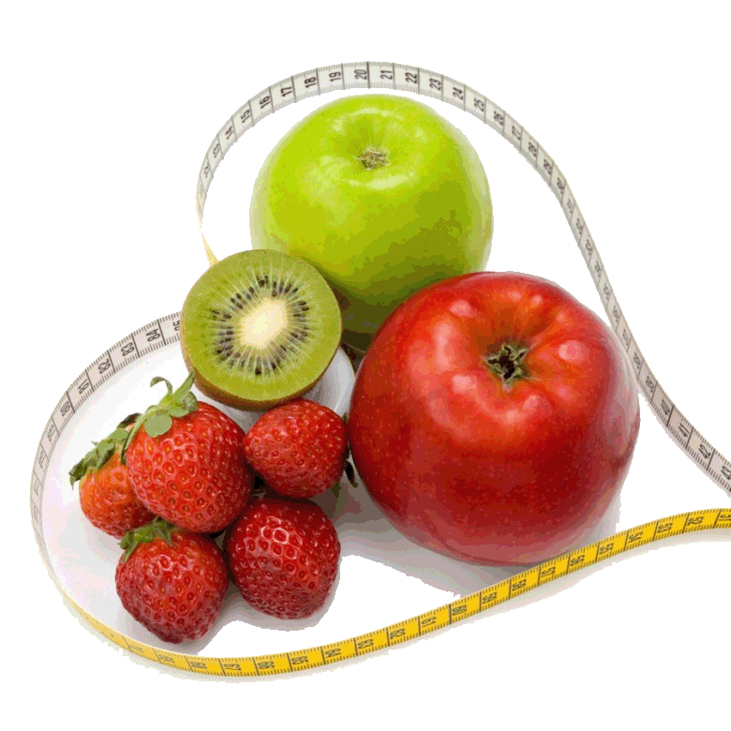
«Dishes. Eating Habits»

Slide 2
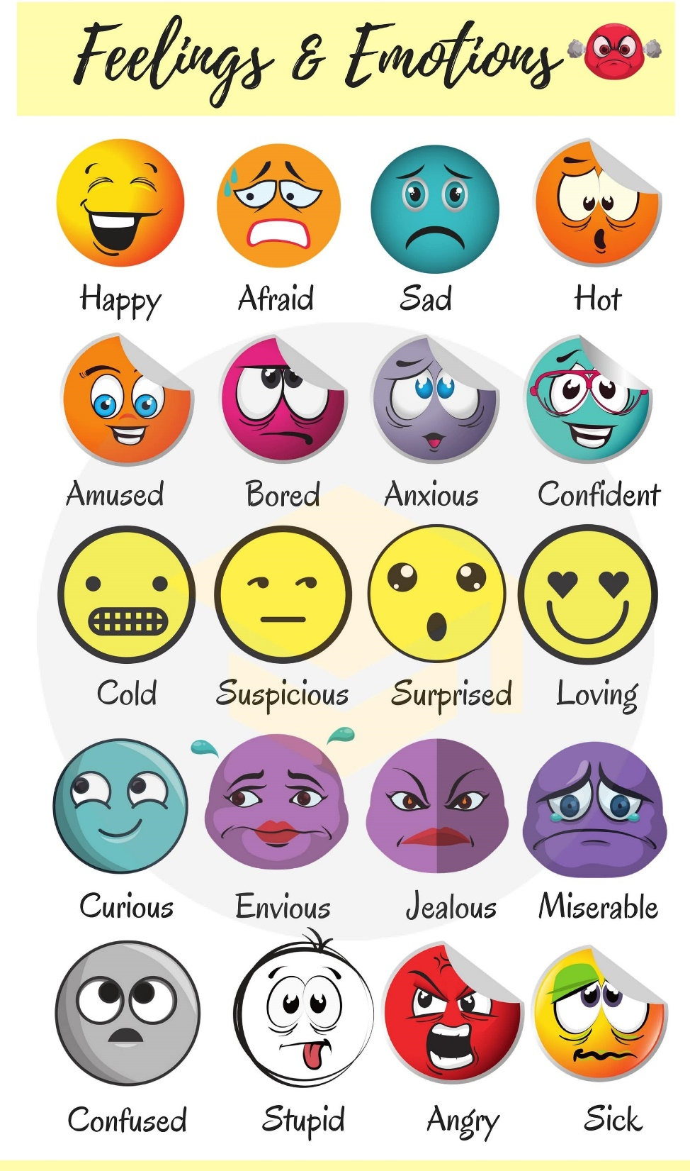
Feelings and Emotions
I am …..
because …..

Slide 3
«Dishes. Eating Habits»

Slide 4
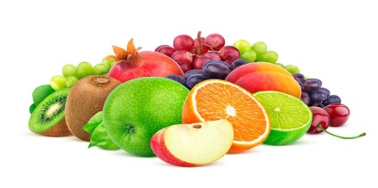
Vocabulary Practice
name five red fruits;
name five yellow or orange fruits;
name five green vegetables;
name five products made of milk;
name five ways of cooking.

Slide 5
Read and find the odd word. Explain your choice.
Cheese, milk, sausage,
yoghurt, butter
Fruit, juice, tea, lemonade,
coffee

Slide 6
Read and find the odd word. Explain your choice.
Pizza, spaghetti, omelette, napkin, porridge
Knife, oil, spoon, folk, plate

Slide 7
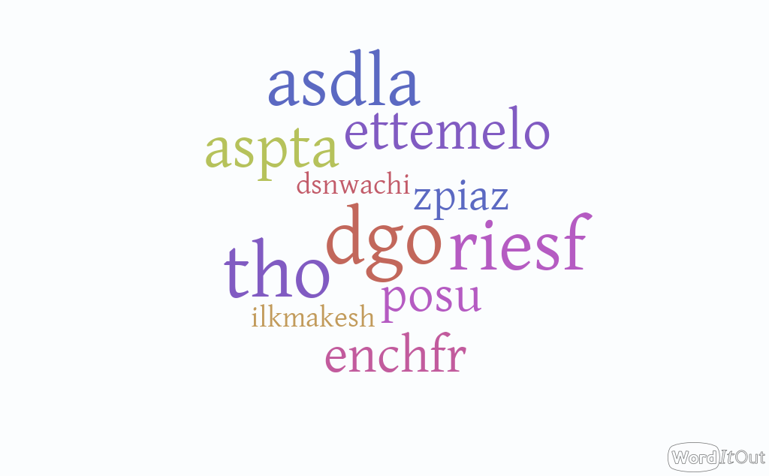

Slide 8
Match the beginnings and the endings
1.Appetite comes
2.Every cook praises
3.An apple a day
4.Forbidden fruit
5.No song,
6.Breakfast like a king,
7.When life throws you lemons,
8.Quick at meat,
a)his own broth.
b)dinner like a queen, supper like a pauper.
c)no supper.
d)with eating.
e)keeps the doctor away.
f)is sweet.
g)quick at work.
h)make lemonade.

Slide 9
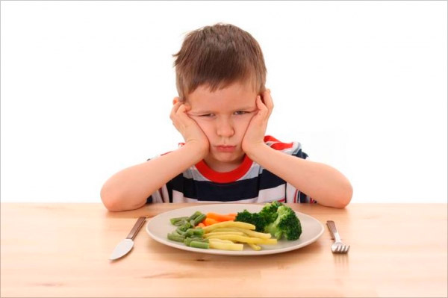
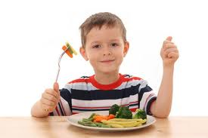
Appetite comes with eating.

Slide 10
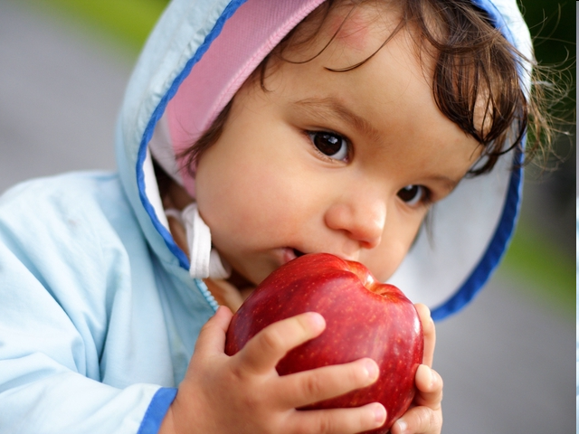
An apple a day keeps the doctor away.

Slide 11
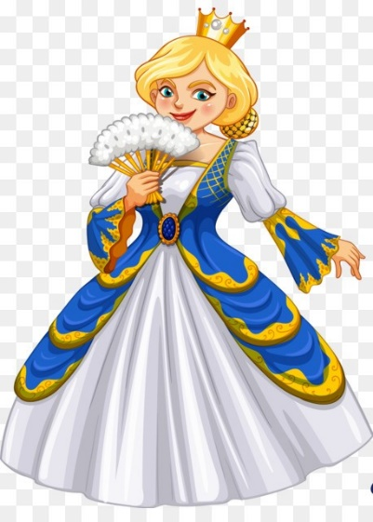
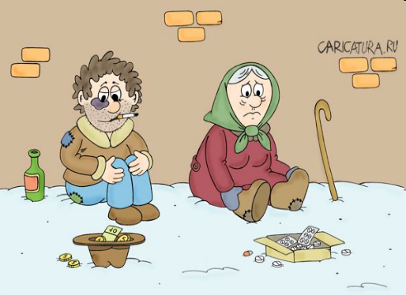
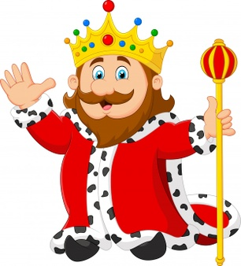
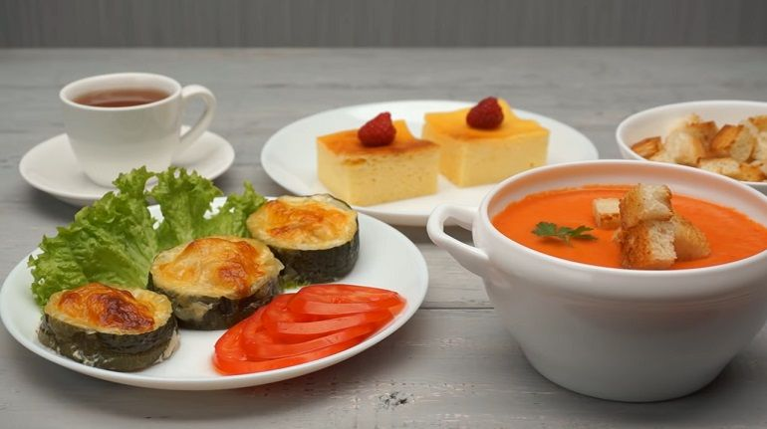
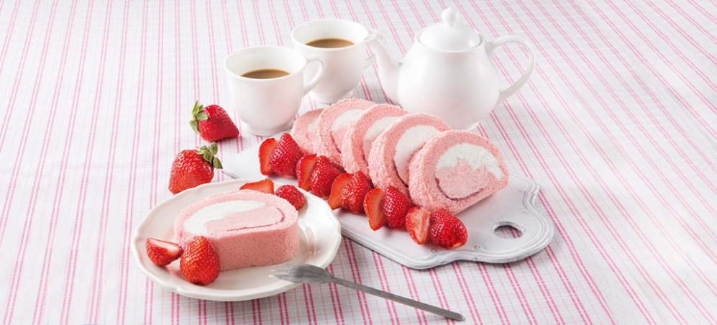
Breakfast like a king, dinner like a queen, supper like a pauper.

Slide 12
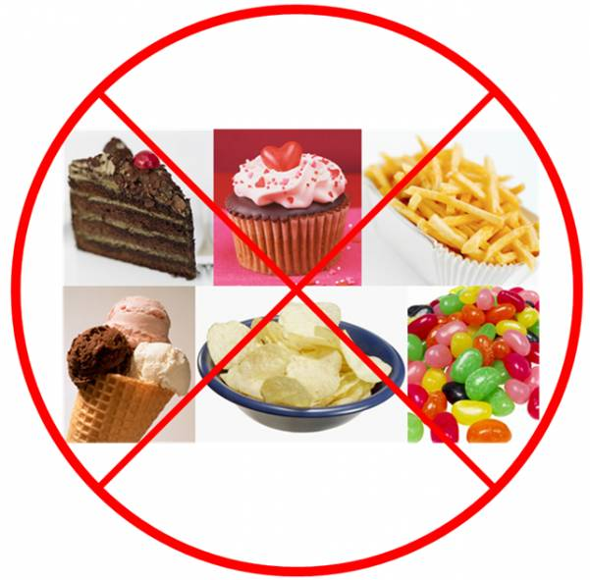
No song, no supper.

Slide 13
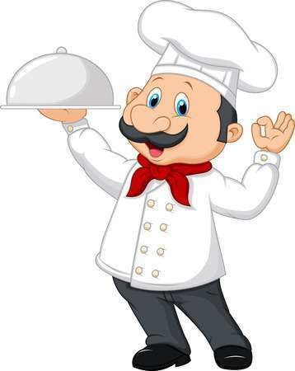
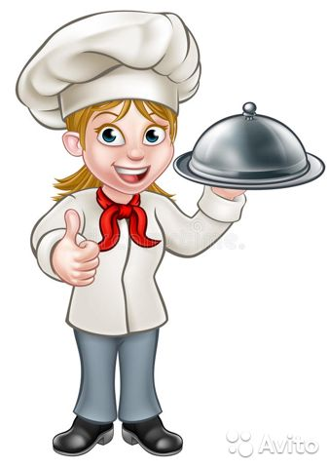
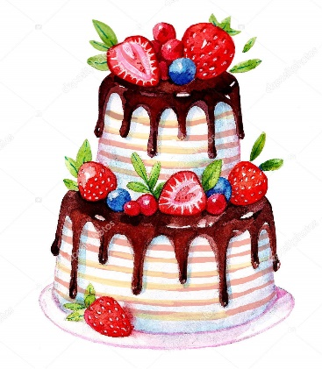
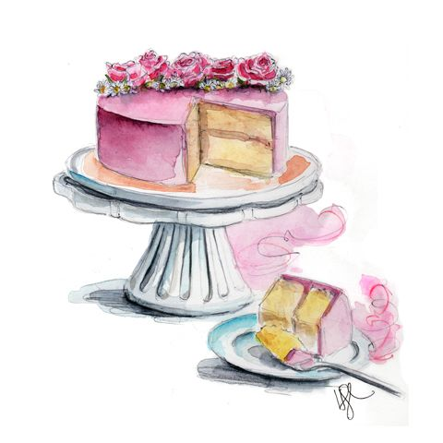
Every cook praises his own broth.

Slide 14
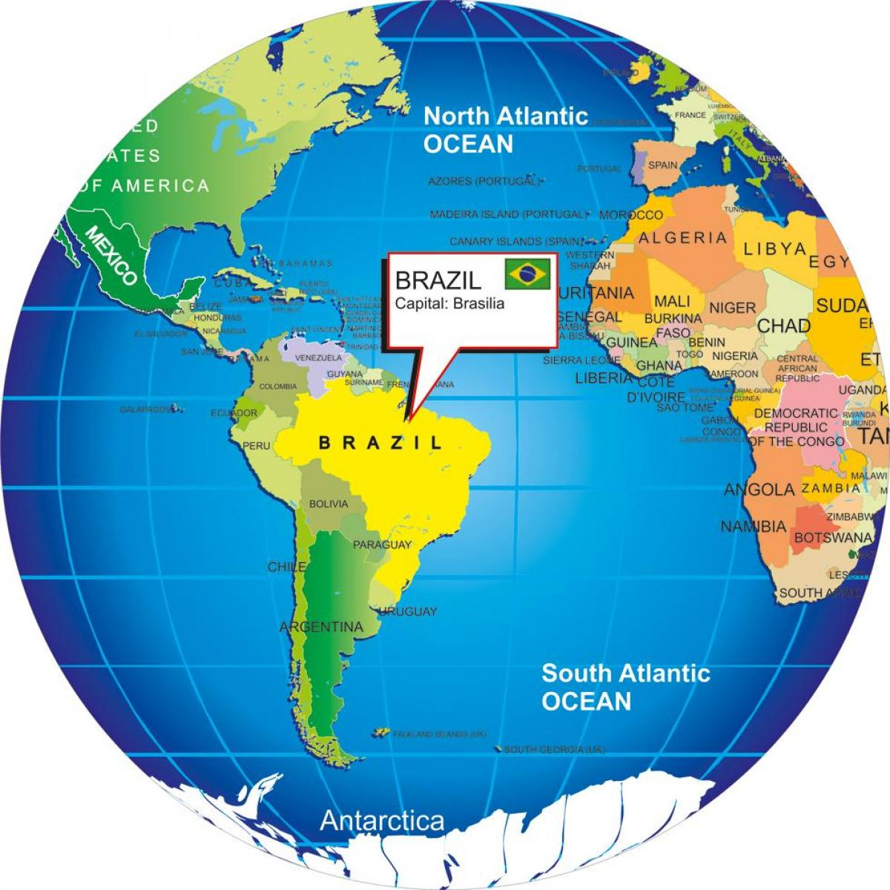
Pre-reading activity Brazil

Slide 15
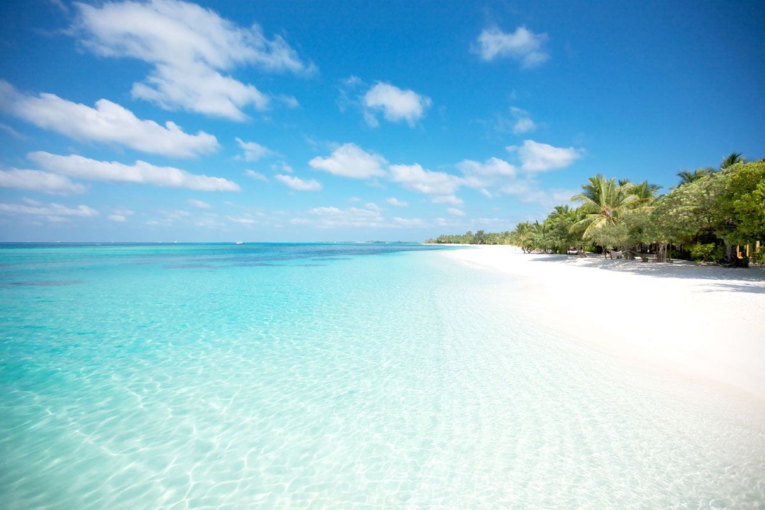
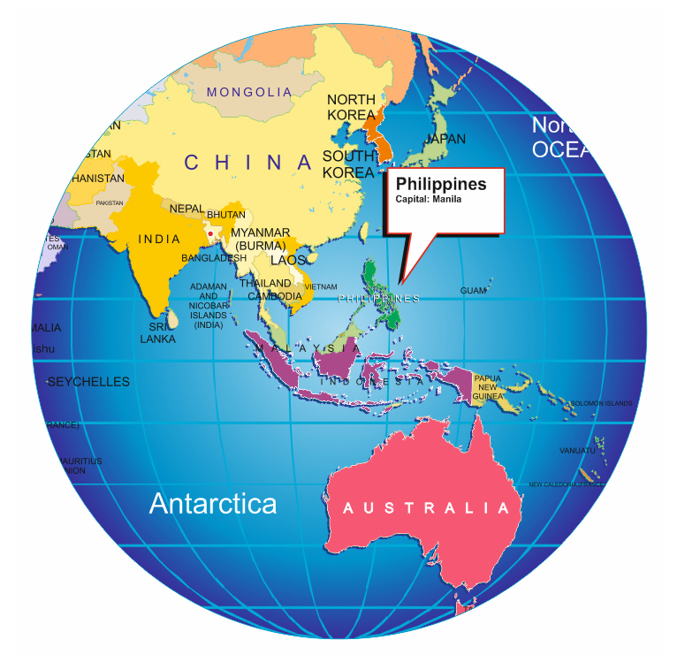
The Philippines

Slide 16
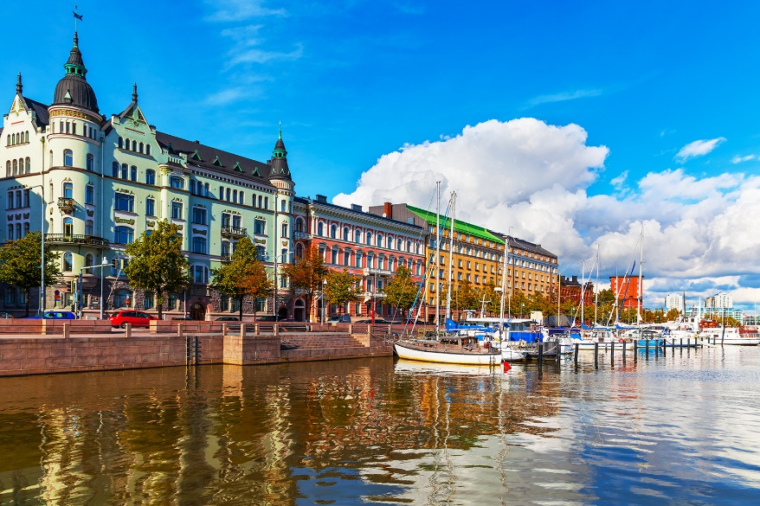
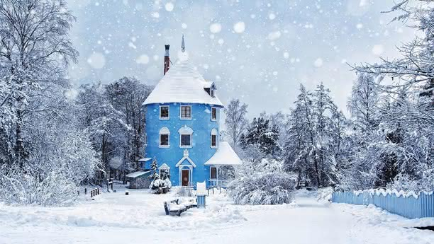
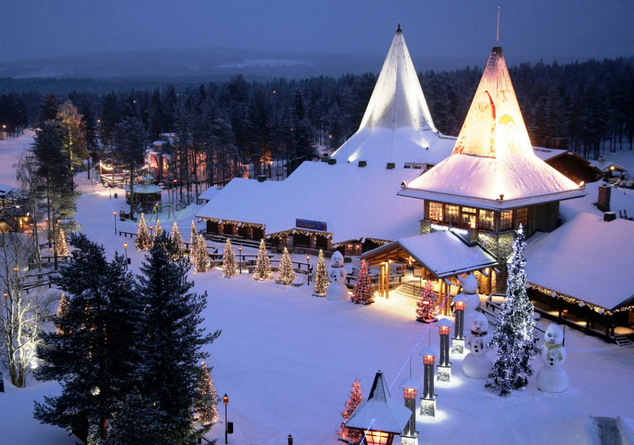
Finland

Slide 17
«Insert»
- I know this information
+ - It`s new for me
- - I had a different opinion on
this
? - I don`t understand this
information, I need clarification

Slide 18
Eating Habits in Different Countries
Tastes differ. It’s true when we speak about table manners and eating habits in different countries. For example, in Britain, you mustn’t lift your soup plate to your mouth. In Japan, however, lifting your plate to your mouse is a traditional way of drinking soup. We know a lot about Great Britain, the USA, Canada and other English-speaking countries. Read more about eating
habits in other lands.

Slide 19
Meet bright Brazil, sunny Philippines and snowy Finland!
Whether at home or in a restaurant, Brazilians like eating with their friends and family. They never eat lunch at the office and they have dinner very late – at about ten o’clock at night.
Brazilians like small cups of strong coffee, at any time of the day. They don’t eat in the street or on the bus, and their never eat with their hands. They always use a knife and fork
to eat, even for pizza or
sandwiches.

Slide 20
The Philippines is not less exotic country than Brazil and has its own eating traditions. Many Filipinos have three meals a day with two snacks in between. Rice is a part of every meal – they even make desserts with rice and coconut milk. Filipinos like eating soup, meat, vegetables and a lot of different sauces.
Families usually eat together and they like to invite people to eat with them. Filipinos eat with a fork and a spoon, or with their hands. It’s polite to leave a little
food on the plate at the end
of a meal.

Slide 21
The food of Finland is a big surprise.
There are a lot of different Finnish dishes, such as smoked fish and hot soups, but fast food such as pizza and sausages are also very popular. In the streets there are stalls which sell sausages, Finland’s favourite food.
During the week, most families don’t usually have dinner together. Sometimes at the weekends they eat with their friends. They cook meals together, or each person makes and
brings a part of the meal.

Slide 22
«True-false quiz»
1.Brazilians prefer eating with their friends and relatives.
True
2. The people of Brazil like to eat lunch at their working place.
False
3. They have dinner almost at night.
True
4. Brazilians like big cups of strong coffee.
False

Slide 23
5. They drink coffee during all day.
True
6. Brazilians always eat with a knife and a fork, even pizza or sandwiches.
True
7. They like to eat everywhere.
False
8. Many Filipinos eat five times a day.
True

Slide 24
9. A part of every meal in the Philippines is buckwheat.
False
10. It isn’t polite to leave a little food on the plate at the end of a meal in the Philippines.
False
11. Finns’ favourite food is sausages.
True
12. In Finland people like to prepare meal together at the weekends.
True

Slide 25
Find the antonyms for the for underlined words in the text
Late – early
Small – large, big, great
Different – same, similar
Polite – impolite
To sell – to buy
Popular – unpopular
Favourite – unloved
Weekend – weekdays

Slide 27
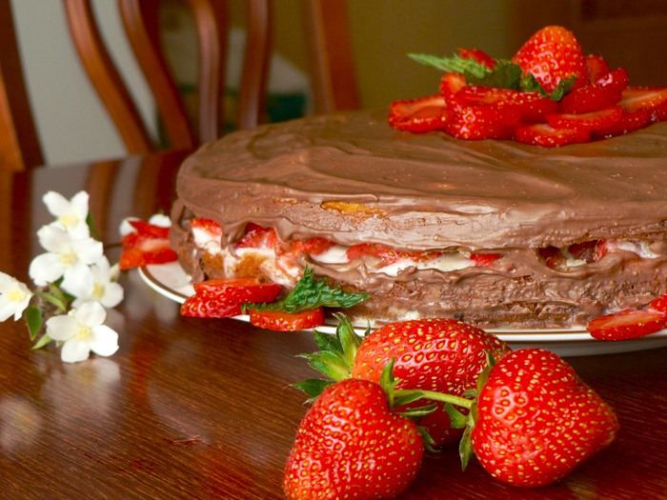
Homework
Find and write the
information about
eating habits
in the country that
you like.

Slide 28
Thank you very much!

