Slide 2
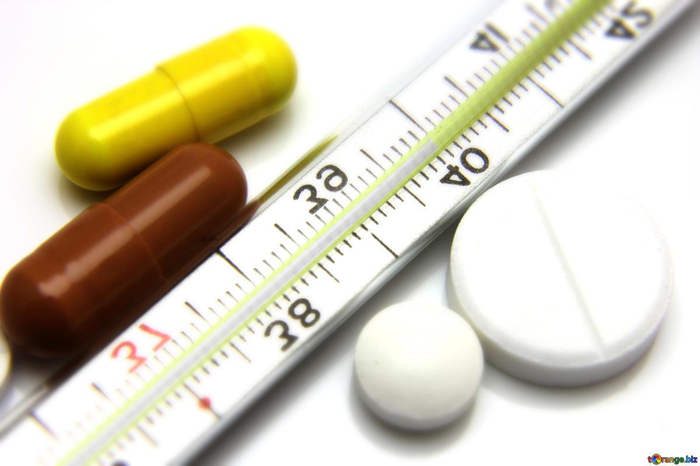
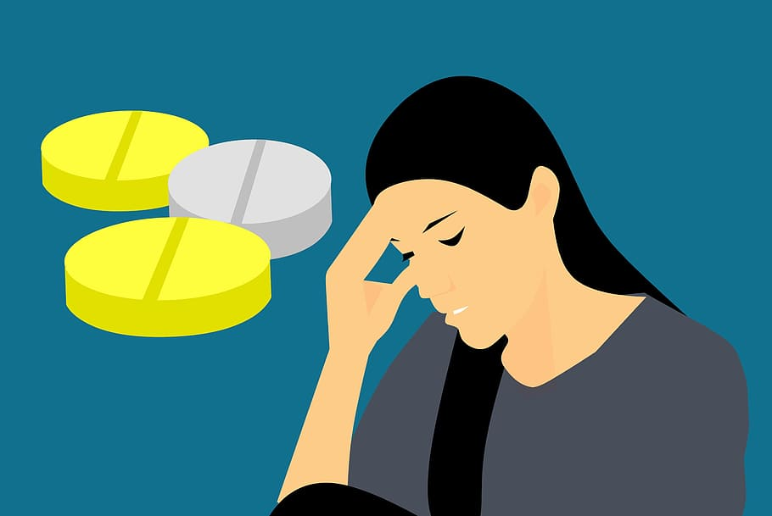
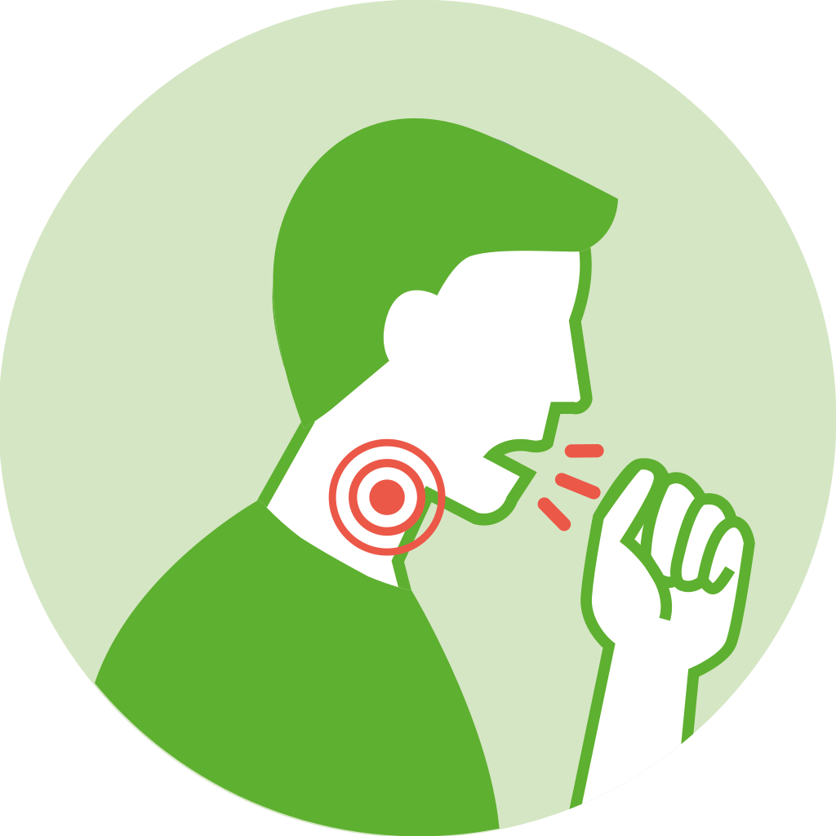
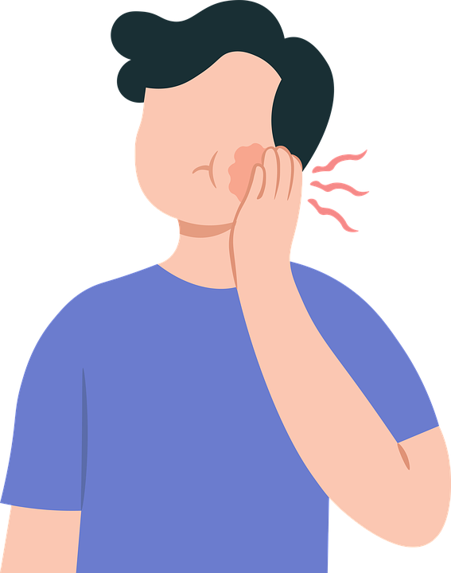
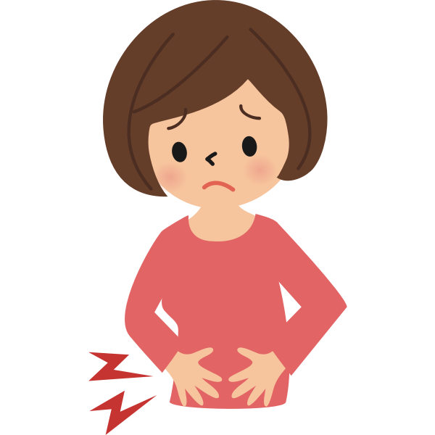
Why do people need to see the doctor?
if they are ill
if they have symptoms (signs) of diseases
a cough
a high temperature
a headache
a toothache
a stomach ache
an earache
a sore throat

Slide 3
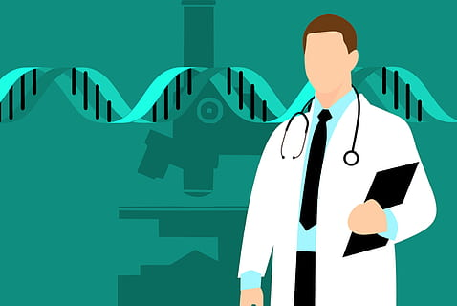
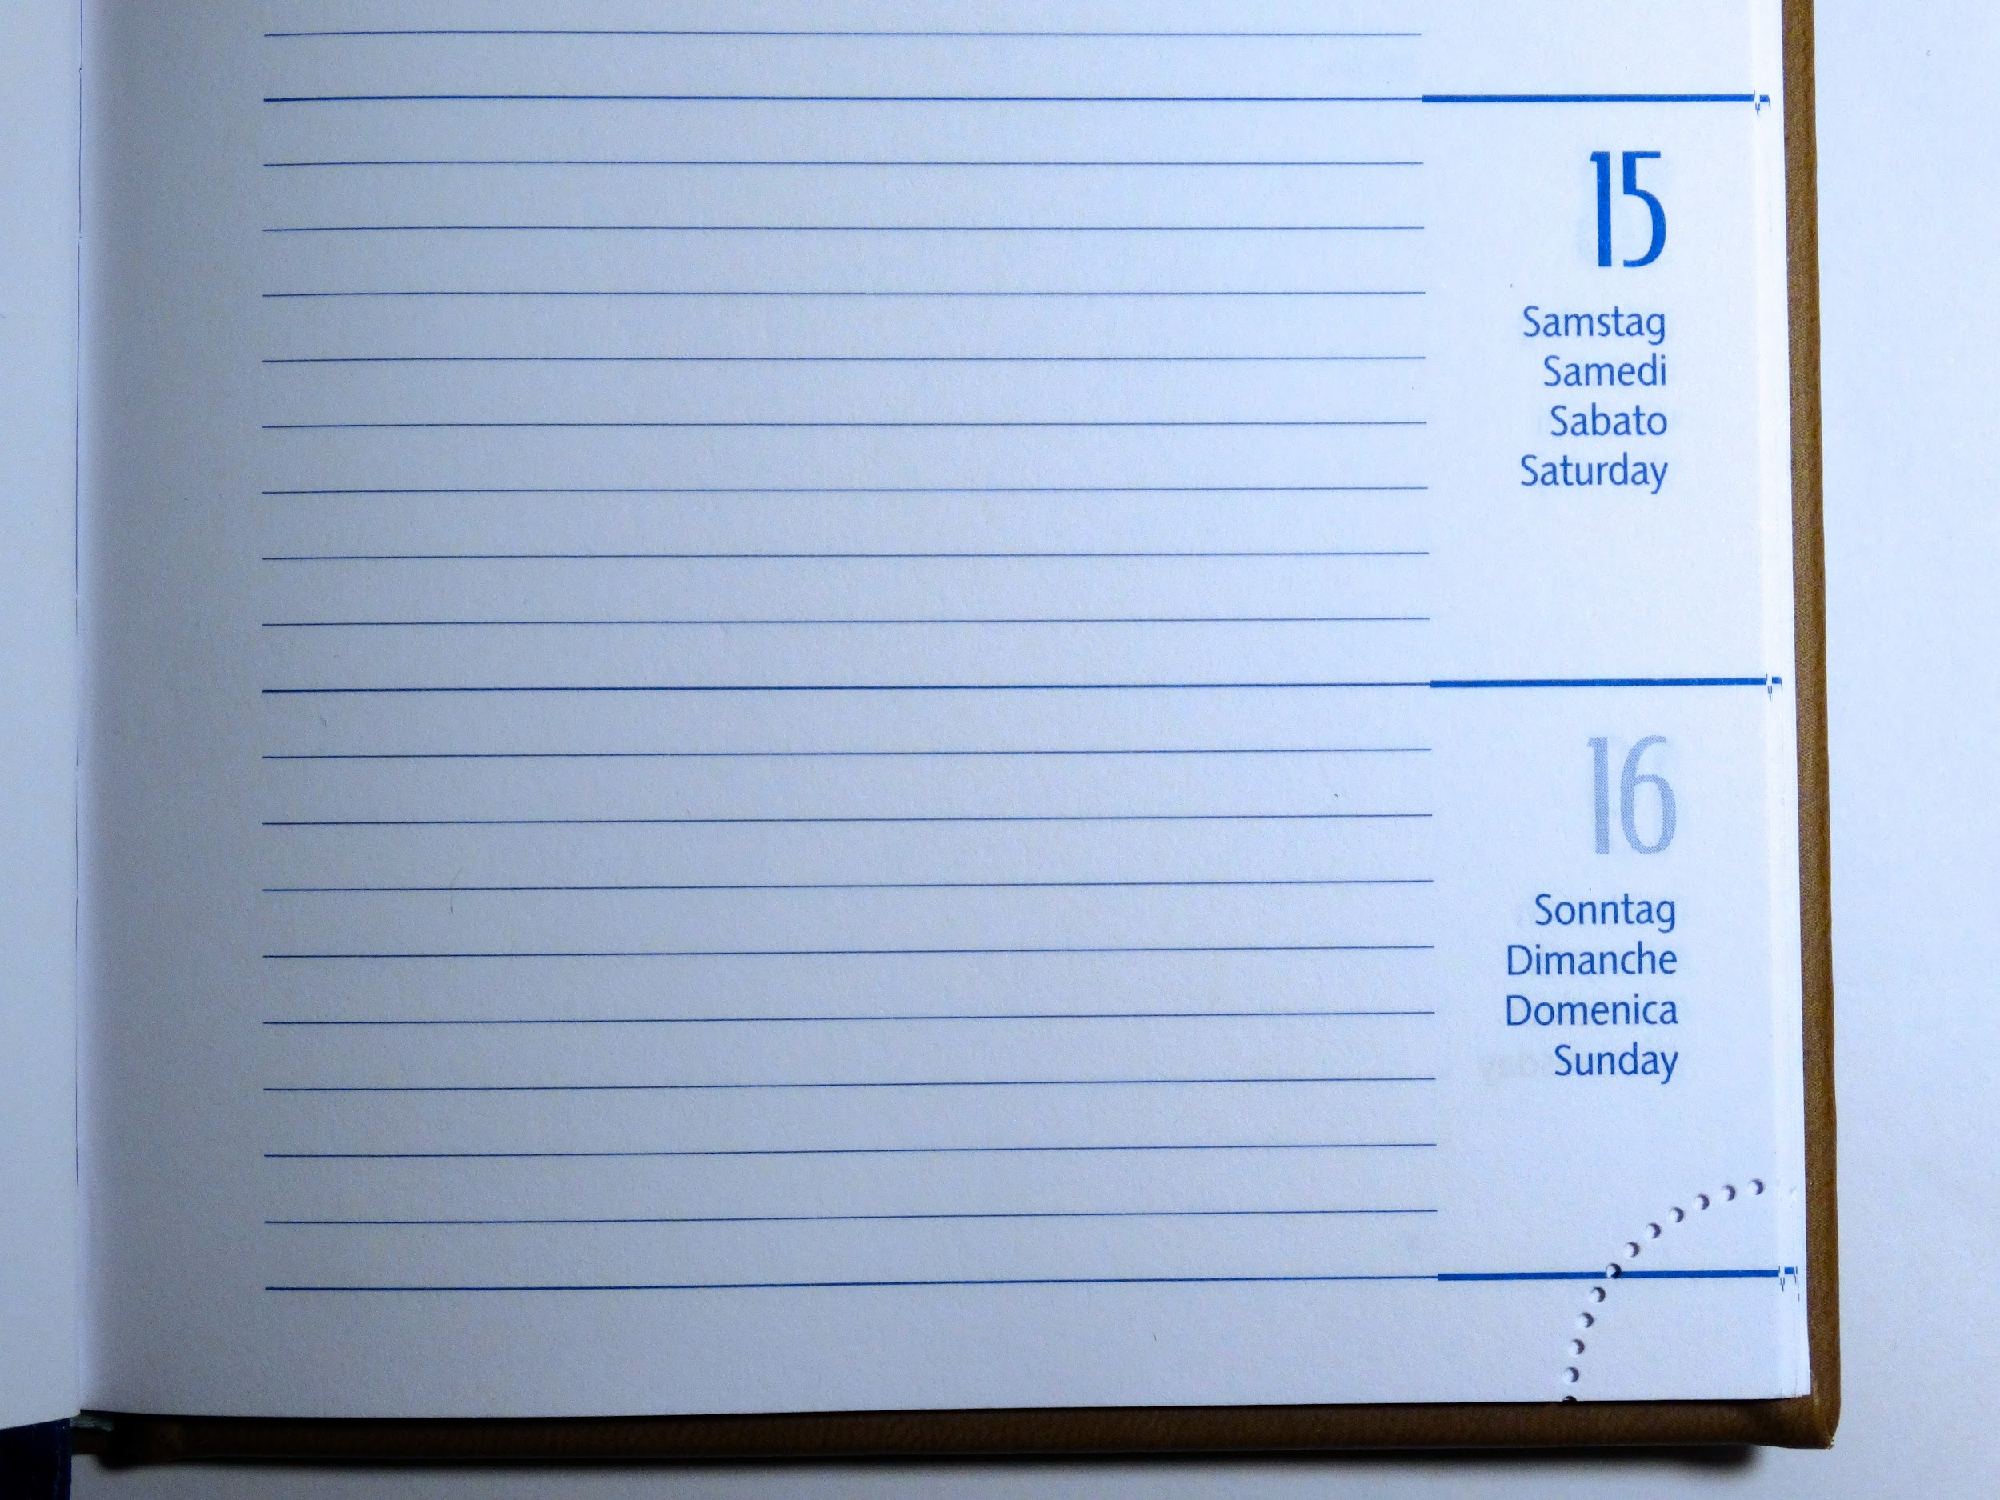
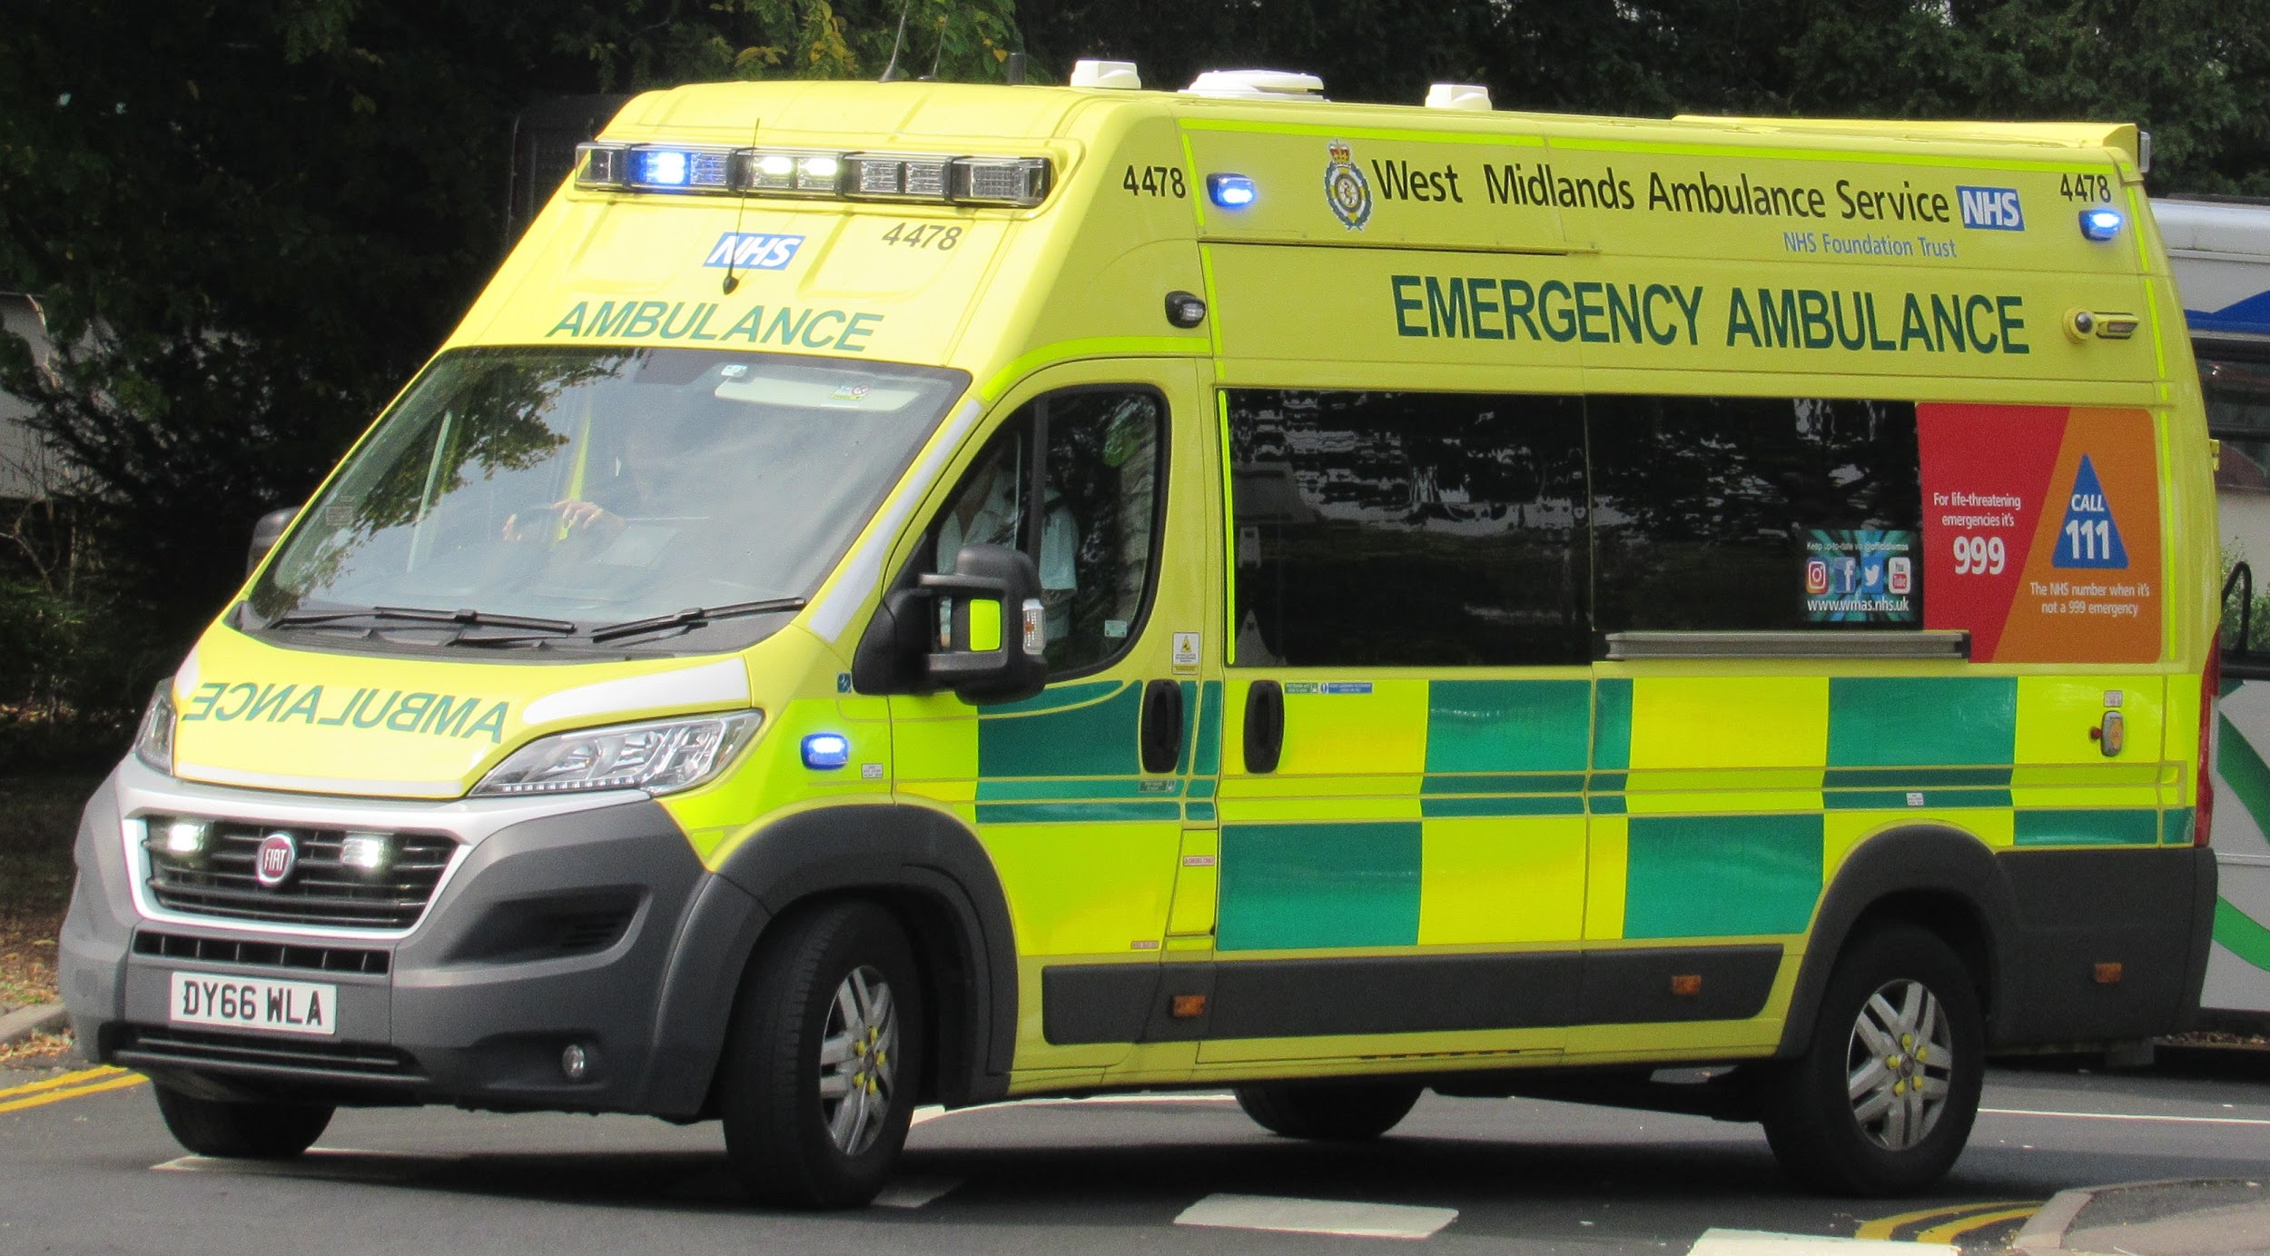
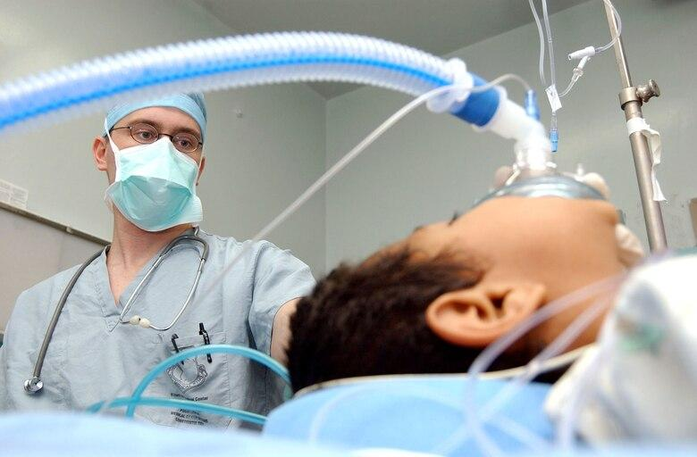
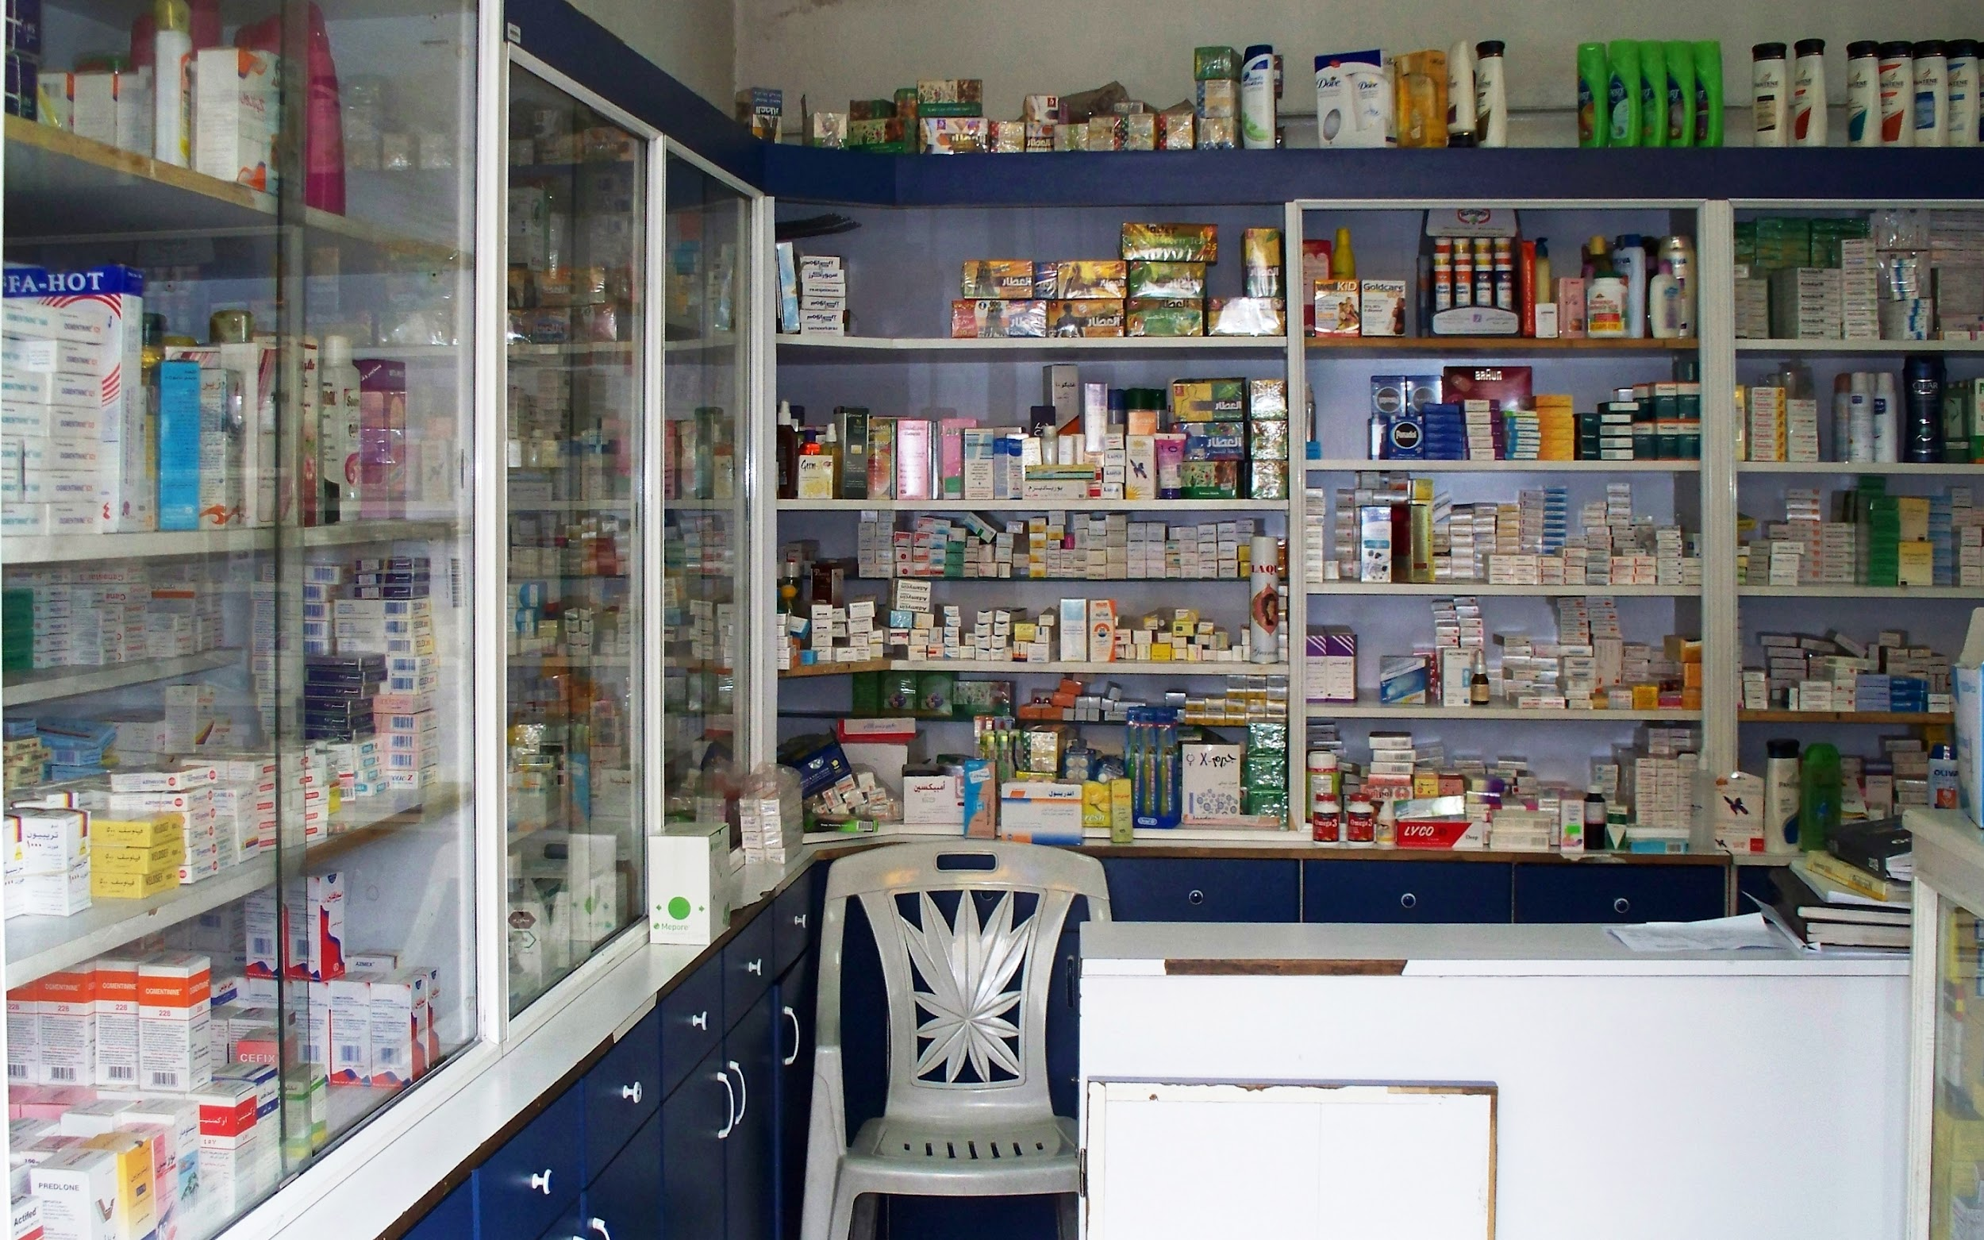
What should sick people do?
see the local doctor first
make an appointment
stay in bed
send for a doctor
go to the Accident and Emergency department
stay at the hospital
buy medicines at the chemist’s

Slide 4
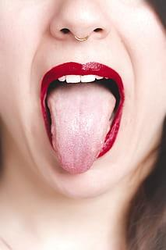
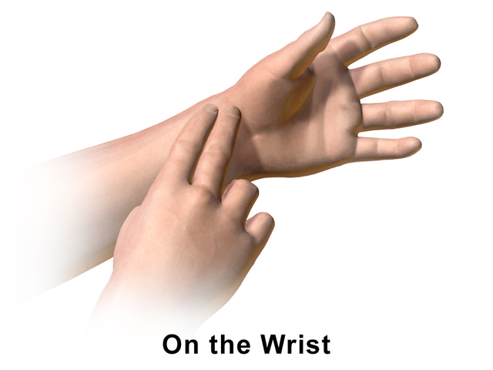
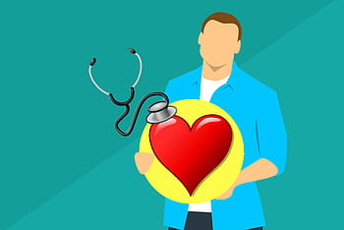
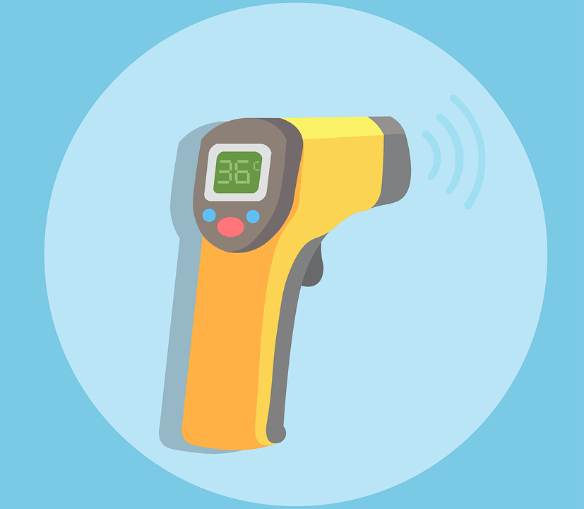
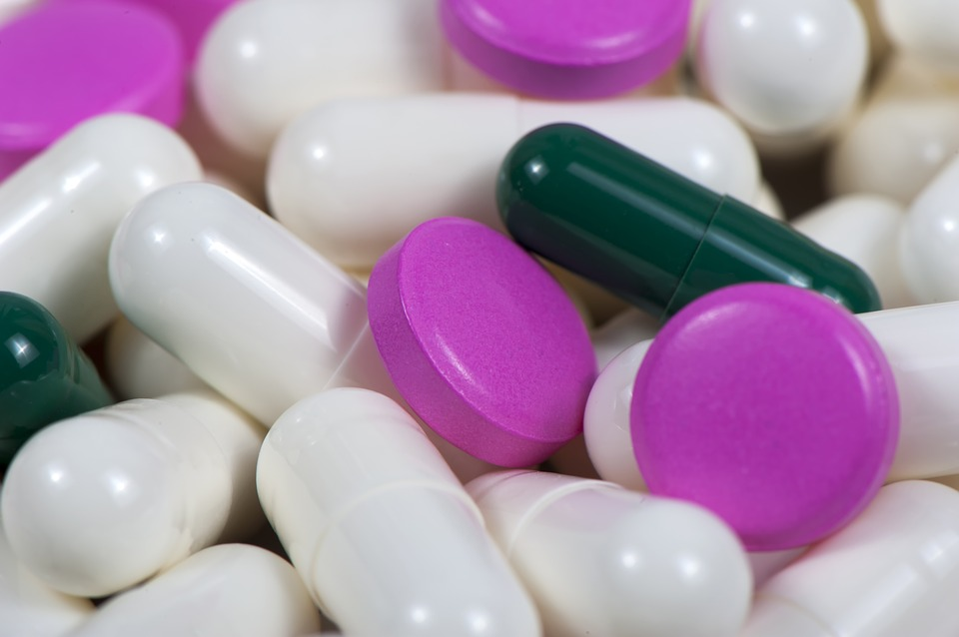
What will the doctor examine?
will ask to describe the symptoms of the illness
will take the pulse
will look at the tongue
will listen to the heart and lungs
will check the temperature
will give some treatment
will send to see a specialist

Slide 5
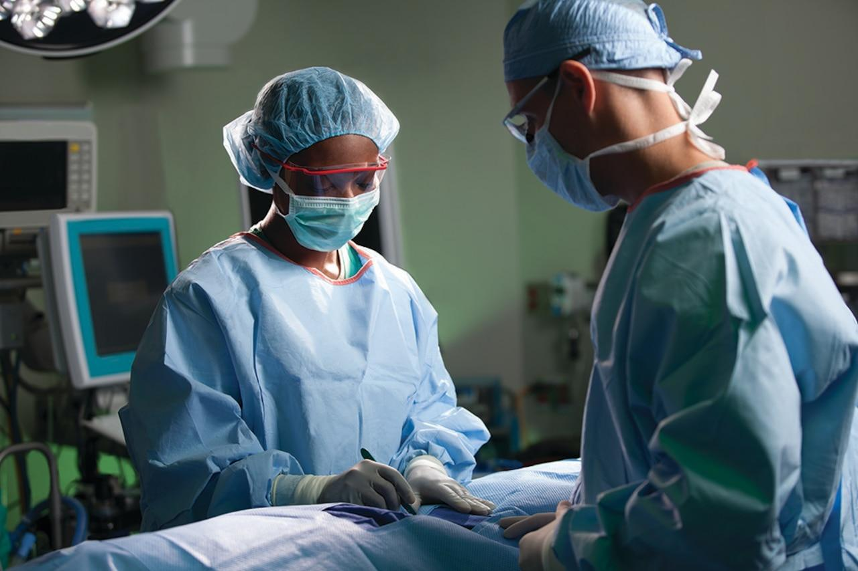
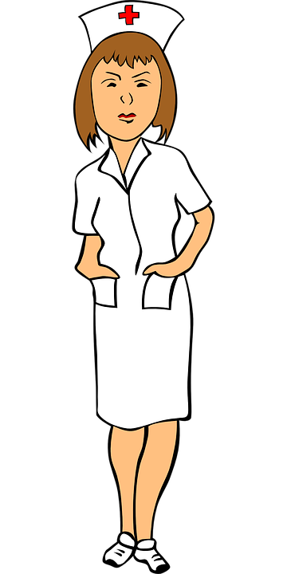
What will the specialist examine?
will examine a patient
will prescribe some treatment (medicines, pills, tablets)
a surgeon will make operations
a nurse will take care of patients

Slide 6
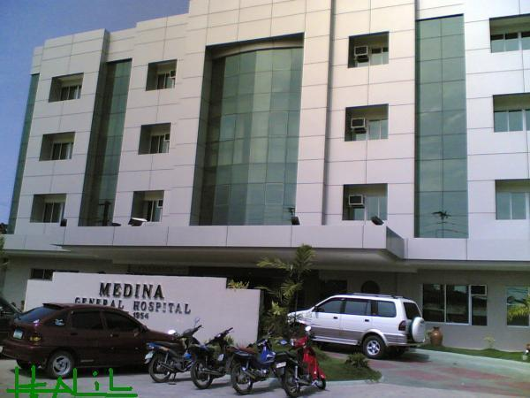
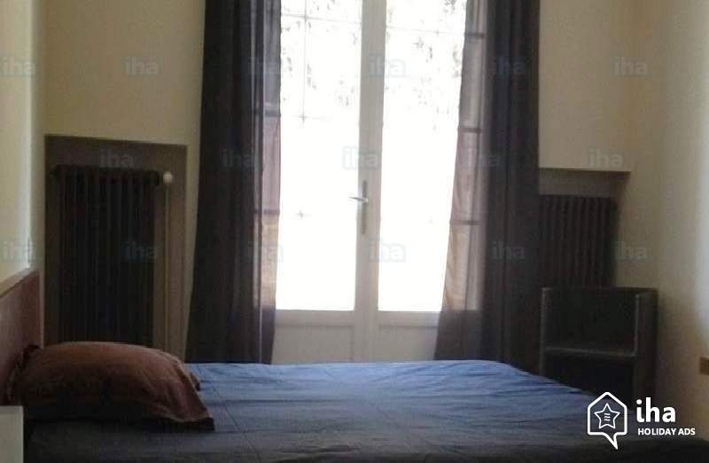
What are private hospitals?
go to a private doctor
pay for treatment
get private treatment

Slide 7
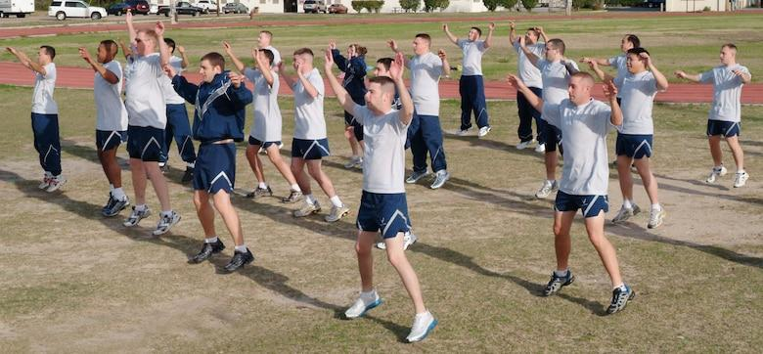
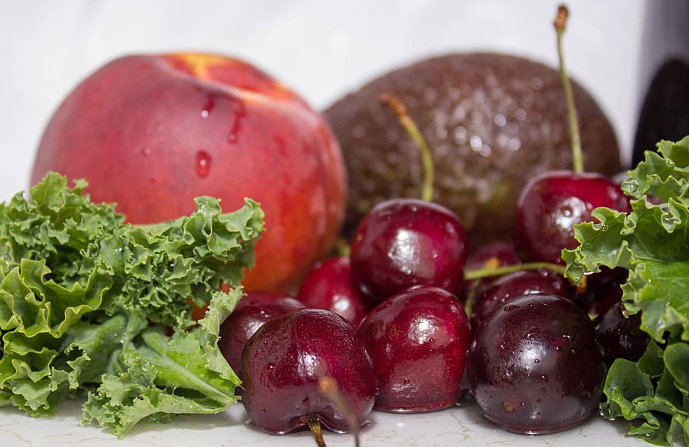
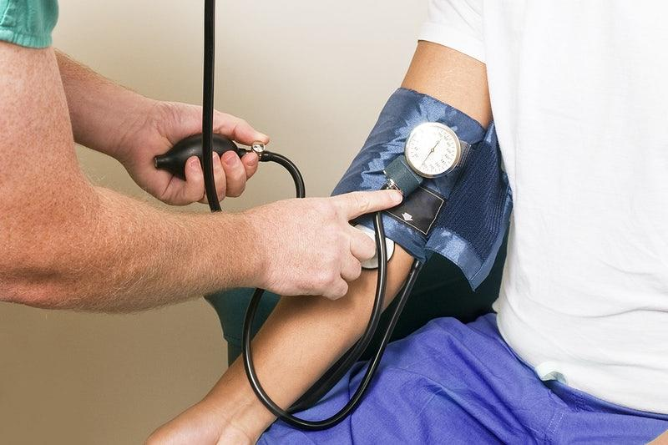
What does a healthy lifestyle mean?
do regular physical exercise
be outdoors
eat only healthy food
get enough sleep
take vitamins
have a complete physical examination

