Slide 1
Clothes We Wear

Slide 2
https://www.youtube.com/watch?v=sQbSfZu26B8

Slide 3
What are you wearing today?
Do you wear any special clothes for your distance learning?
Are your clothes comfortable and warm enough?
Do you put on your school uniforms for the distance lessons?
Speaking

Slide 4
in winter/in summer/ at school
A sweater, a T-shirt, a blouse, a coat, a scarf, a suit, trainers, boots, gloves, a hat, socks, a dress, shorts, jeans, a pair of jeans, mom jeans, skinny jeans, baggy jeans, hoody/hoodie, a sweatshirt, oversize, trousers, a pair of trousers, a jacket, a uniform, a scarf, tights.

Slide 5
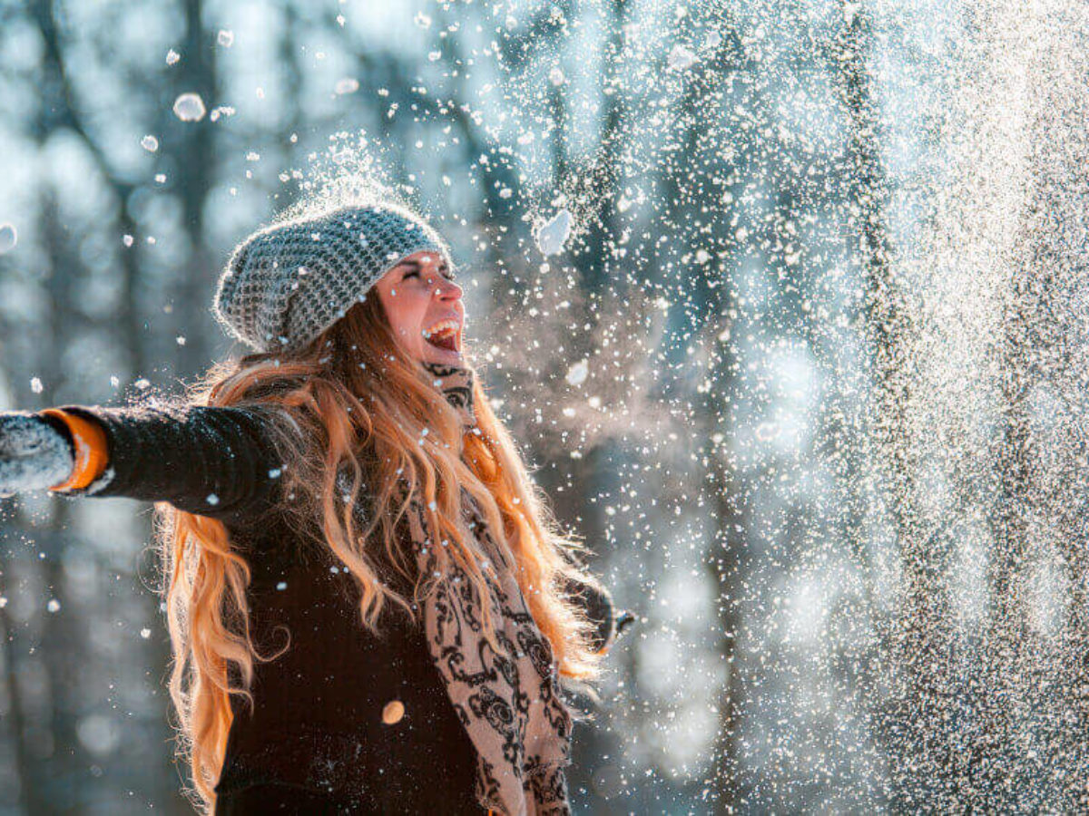
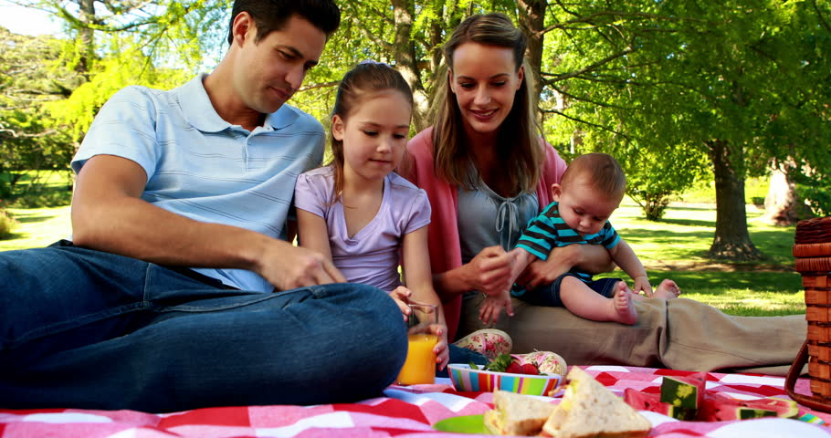
at school
in summer
in winter
on a picnic

Slide 6
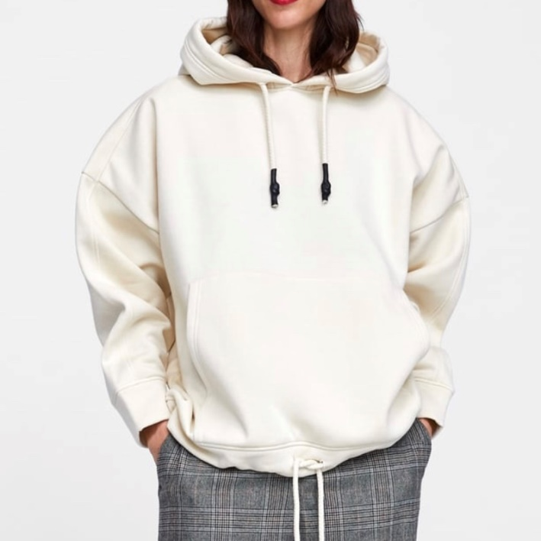
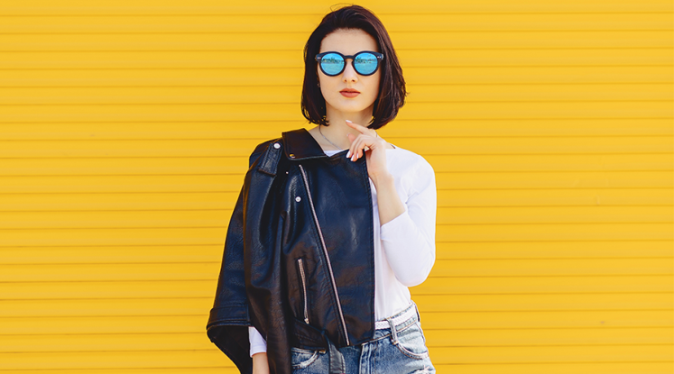
What's wrong?
It is hot. Sue is wearing a green hat.
Liz is wearing grey mom jeans.
Jane is wearing a pink hoodie.
Ann is wearing a red sweater.

Slide 7
Read and translate:
blue jeans
a short skirt
a long dress
a big black jacket
a pink blouse
a red T-shirt
comfortable trainers
warm clothes

Slide 8
Be active!
Baggy jeans are in fashion now.
Oversize clothes are comfortable for me.
My new sweater is loose.
My hat doesn’t match to my coat.
This green jacket doesn’t fit me.
The red skirt is too short for me.

Slide 9
T
E
S
T
Y
O
U
R
S
E
L
F

Slide 10
Homework
Task 1
Answer the question.
Task 2
Exercise 2 page 30,
orally

Slide 11
English !!! I LOVE it!
Listen and learn
https://www.youtube.com/watch?v=pHer1COWyrQ
https://www.youtube.com/watch?v=rJXUpEkWhjc
2. Practice your writing and spelling skills
https://naurok.com.ua/test/clothes-form-5-1092810.html

