Slide 3

Full Blast Plus 6 for Ukraine Module 2A | Quizlet

Slide 4

https://play.kahoot.it/v2/?quizId=16e947c7-ea50-4dc9-a278-77c6ba5c07b1

Slide 5

https://learningapps.org/display?v=pnnhjkvec24
Full Blast 6 2a

Slide 6
Past Simple Tense
Affirmative | Subject + V2 | He went to the store yesterday.
Negative | Subject + did not (didn't) + V1 | He didn't go to the store yesterday.
Questions | Did + subject + V1? | Did he go to the store yesterday?

Slide 7

https://www.baamboozle.com/game/116960

Slide 8
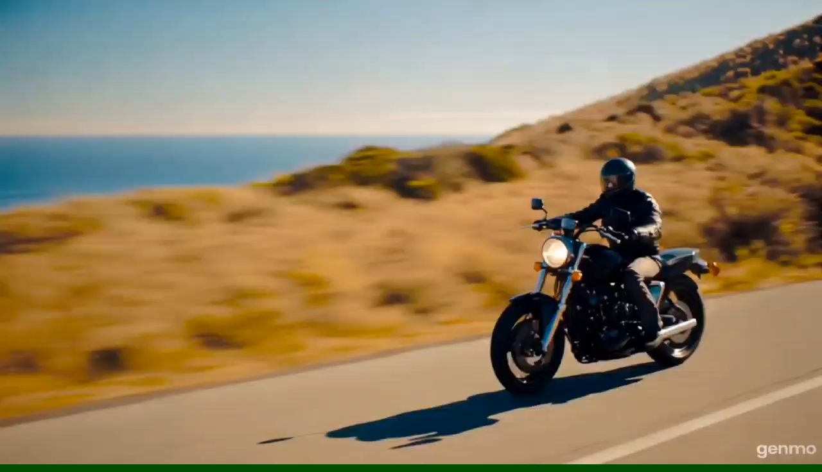

Slide 9

https://naurok.com.ua/test/noliday-activity-full-blast-6-p-21-past-simple-3043006.html

