Slide 1
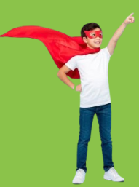
GOOD
ROLE MODELS

Slide 2
Look at some useful expressions which will help you tell about people who influence you in a good way
look up to somebody for something (phrasal verb) –
admire or respect someone for a particular quality, skill
e.g. I’ve always looked up to Bill for his courage and
determination.
set a good/positive example for somebody by doing something – show by your own behavior how other people should behave
e.g. Parents should set a good example for their children by
being active and keeping fit.
be a good/positive influence on somebody –
have a positive impact on someone’s behaviour
e.g. Helen is a good influence on him. or Her kindness and
patience are a good influence on her children.

Slide 3
Complete the sentences with the expressions from the box:
look up to / set a good example/ be a good influence
1. Does she_________________ for teenagers?
2. How can parents _________________ on their children’s academic success?
3. Many students ________ their teachers for academic guidance.
4. His bravery can_________________ on his friends.
set a good example
be a good influence
look up to
be a good influence

Slide 4
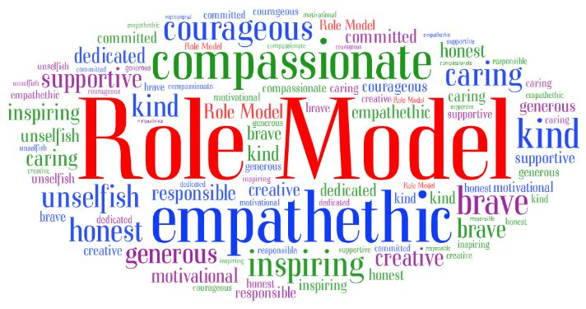
Look at the word cloud of positive qualities that good role models possess and find those qualities you haven’t mentioned yet

Slide 5
Read the sentences below and match the adjectives in bold with the definition a-h
1. Oliver is an inspiring leader who motivates his team every day.
2. Mary is a kind and empathetic friend.
3. Alice is a compassionate woman who is always ready to give a helping hand to those in need.
4. I admire Bill because he is a really courageous person.
a. having the ability to understand other people’s feelings and problems
b. feeling sympathy for people who are suffering
c. having the ability to confront fear, take risks and act in the face of danger
d. giving people a feeling of excitement and a desire to do something great

Slide 6
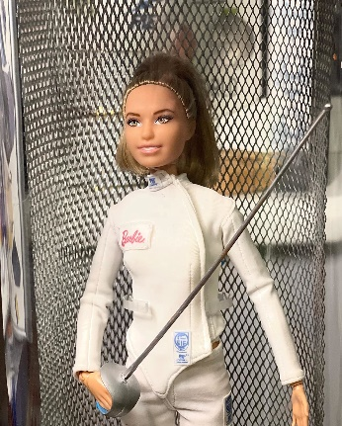
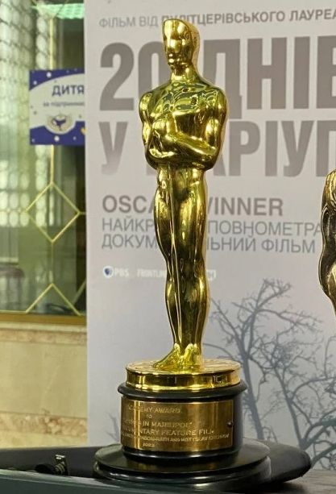
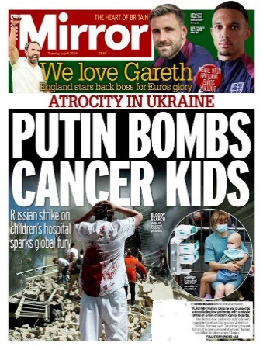
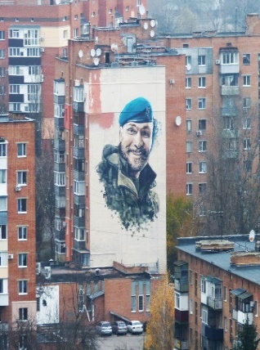
Look at the four items associated with people admired by a lot of Ukrainians.
Identify each item and the sphere of life it represents.

Slide 7
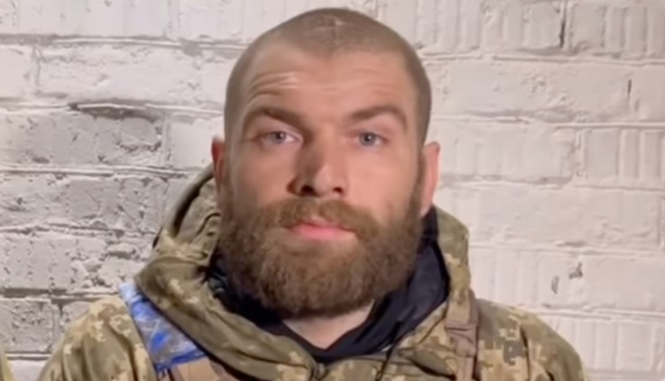
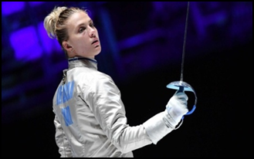
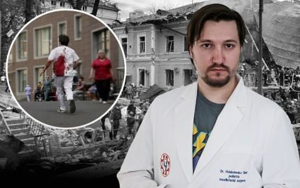
Look at the people whom thousands of Ukrainians admire:
Serhii Volynskyi, a Ukrainian officer, Hero of Ukraine (2022),
military commander of the 36th Separate Marine Brigade,
the “Voice from Azovstal hell”.
Olga Kharlan, a Ukrainian sabre fencer,
a four-time individual women’s world sabre champion,
six-time Olympic medalist.
Oleh Holubchenko, a paediatric surgeon from
Okhmatdyt children’s hospital

Slide 8
While watching the video tick () the true statements
1. It was 20 Days in Mariupol that won the first Oscar in Ukrainian history. ___
2. Mstislav Chernov climbed to the stage alone to make his thank-you speech. ___
3. Mstyslav Chernov said that he wished he had never made this film. ____
4. Mstyslav Chernov believes that while making his films he can change the history and the past. ____
5. In his speech Chernov noted that talented people can record history and make the truth prevail. ____




Slide 9
Now I can
explain what a role model is
use the vocabulary related to the description of good role models
prove that this or that person is a good role model for other people
describe a person who I admire

Slide 11
References
1. https://en.wikipedia.org/wiki/Serhii_Volynskyi
2. https://milesfromnowhere.uk/2023/10/02/poltava/
3. https://stalevi.com/wp-content/uploads/2024/08/stalevi_eng.pdf
4. https://www.dw.com/en/ukrainian-fencer-disqualified-for-refusing-russian-handshake/a-66366477
5. https://rubryka.com/en/2023/08/30/imennu-barbi-ukrayinskoyi-olimpijskoyi-chempionky-harlan-prodaly-na-auktsioni-za-10-400/
6. https://www.pravda.com.ua/eng/news/2024/07/9/7464855/
7. https://www.komersant.info/en/ne-vidchuvav-boliu-likar-okhmatdytu-zghadav-moment-udaru-rakety-po-likarni-2/
8. https://www.ukrainianphotographers.com/en/news-articles/oscar-goes-to-mstyslav-chernov

