Slide 1
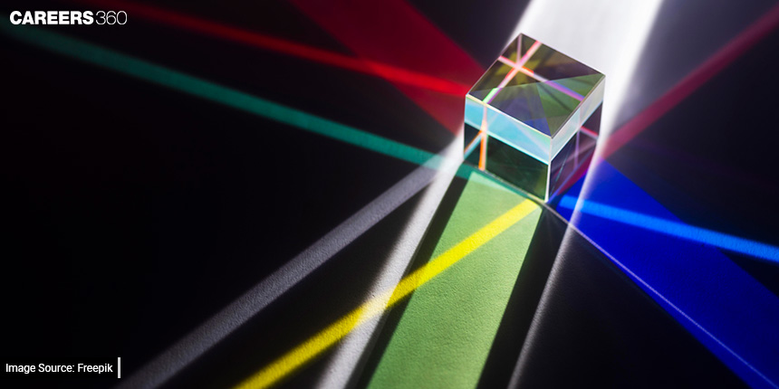
“Application of Optics to Various Professional Spheres”

Slide 2
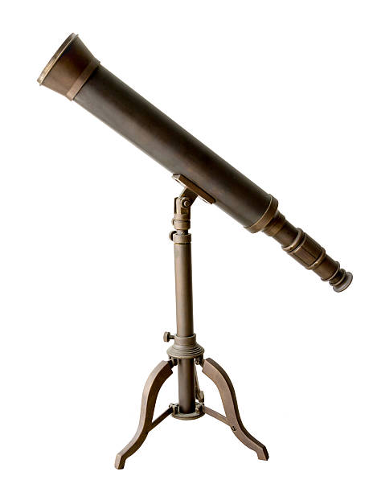
Astronomers The history and properties of a telescope

Slide 3
Quiz

Slide 4
Biologists
During the 1st
century AD, glass had been invented
and the Romans were looking
through the glass and testing it.
They experimented
with glass in different shapes
and eventually found that different thickness
of glass could produce magnification by
holding one of these “lenses”
over an object.

Slide 5
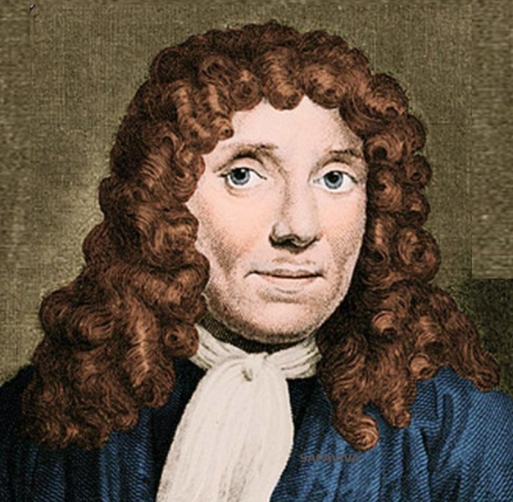
The early simple
“microscopes” which were really only magnifying
glasses had one power, usually
about 10x.
People found fleas
interesting to look
at and these early microscopes were frequently
used to view insects.
In the 1660s in Holland, Antonie van Leeuwenhoek
also started experimenting with lenses.
He realized
that he could polish lenses so that
they would have curves on the edges to
produce greater magnification.
His rounded lenses
allowed his microscope
to magnify up to 270x!
Anthonie van Leeuwenhoek (1632-1723)

Slide 6
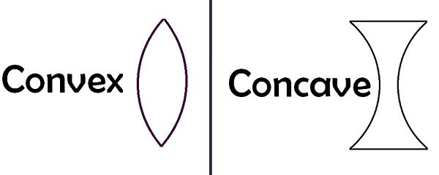
Leeuwenhoek is often called
the father of microscopy due
to his discoveries and he is often given credit
for inventing the microscope as well
as convex and concave lenses.

Slide 7
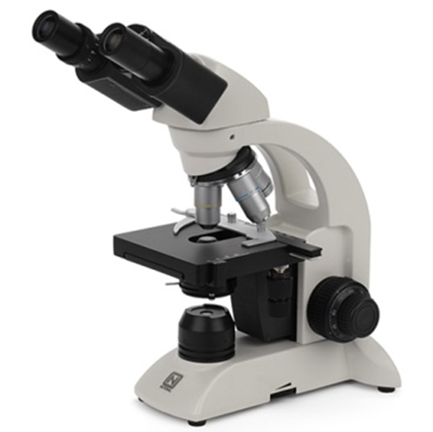
Observe samples under the microscope
Make a detailed description of what you see on the glass.
Make a guess what it might be.

Slide 8
Stunning microscope world
1
2
3
4

Slide 9
Pilots / Aircraft Engineering

Slide 10
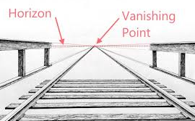
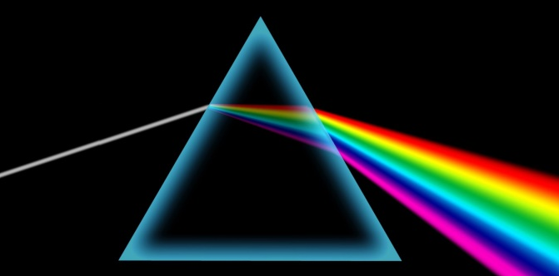
Three non-mentioned words
magnification | transparent | projector
optics | data | collimator
perspective | glass | beam splitter
monochromatic light | refraction | wavelength
magnification
perspective
refraction

Slide 11
IT Sphere
Fiber optic cables

Slide 12
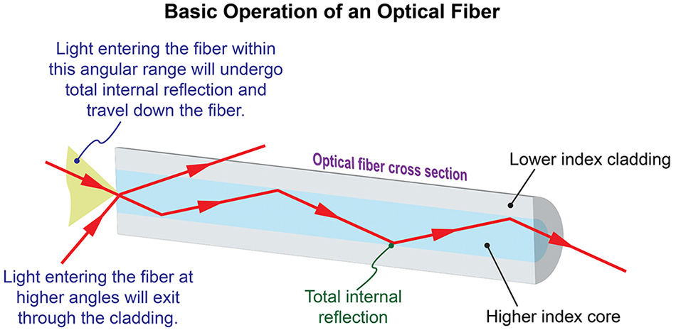
Light travels down a fiber optic cable by bouncing off the walls of the cable repeatedly.

Slide 13
#1 Remote Sensing
Fiber optic cables use/are used/have used as sensors to measure temperature and pressure. Using fiber optic cables in remote sensing is convenient due to / because / because of it doesn’t require any electricity in a remote location.
Fiber optic cables are used as sensors to measure temperature and pressure. Using fiber optic cables in remote sensing is convenient because it doesn’t require any electricity in a remote location.

Slide 14
#2 Medicine
Fiber optic cables are general /generalization/ generally used in in endoscopy (non-intrusive surgical methods). In such a/such/so procedure, a small, bright light is used to light up the surgery area inside the body.
Fiber optic cables are generally used in in endoscopy (non-intrusive surgical methods). In such a procedure, a small, bright light is used to light up the surgery area inside the body.

Slide 15
#3 Decorations and Lighting
Fiber optics are used for lighting decorations and illuminating Christmas trees. They are an easy, attractive, and economic/economical/ economy solution for/to/of lighting projects.
Fiber optics are used for lighting decorations and illuminating Christmas trees. They are an easy, attractive, and economical solution to lighting projects.

Slide 16
#4 Military and Space Applications
Fiber optic cables are the perfect solution to transmitting/transporting/transfering high-security date/data/datas for military and aerospace applications.
Fiber optic cables are the perfect solution to transmitting high-security data for military and aerospace applications.

Slide 17
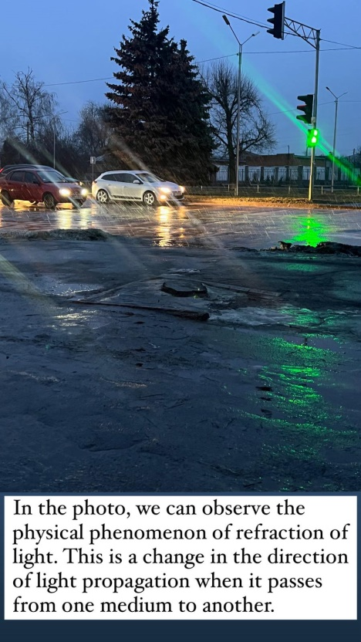
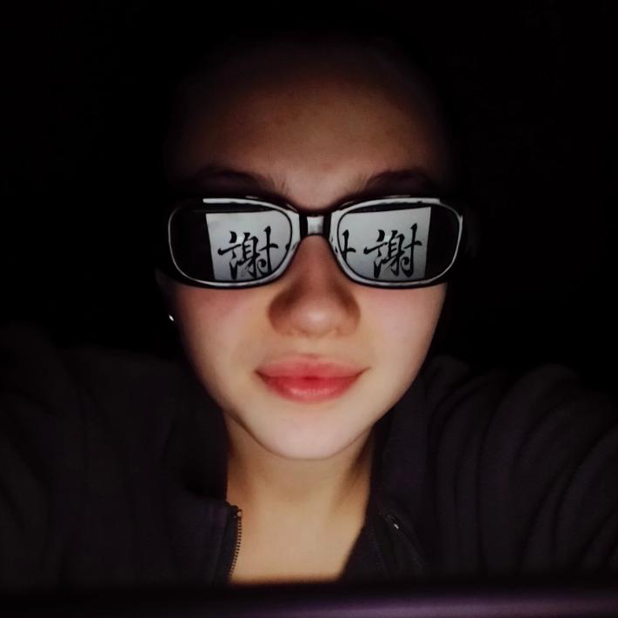
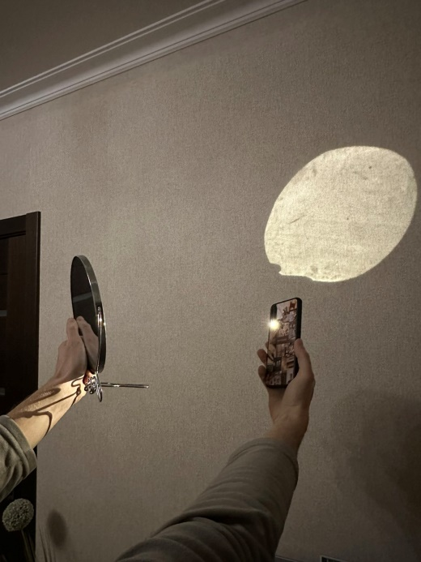
Photographers
Mini photo projects
Experimenting with optics

Slide 18
“Where there is a will there is a way” Albert Einstein

