Slide 5
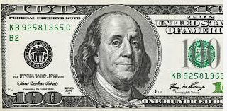
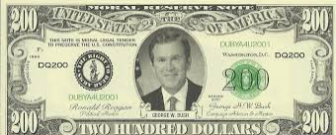
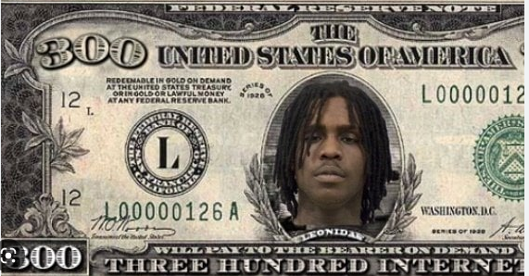
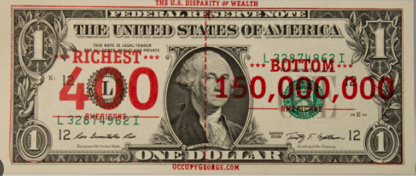
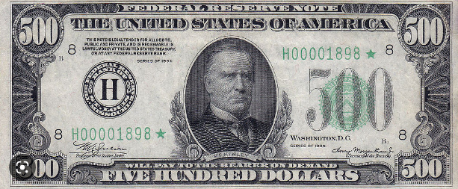
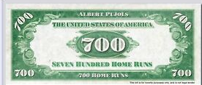
Choose a banknote and do the task

Slide 6
2
1
Name 3 months
Name 3 days of the week
3
4
Name 3 seasons
Name 3 colours

Slide 7
1
2
Name 5 hobbies
Name 5 countries
3
4
Name 5 animals
Name 5 holidays (celebrations)

Slide 8
People have steel drum competitions on this day
1
2
Match the holiday
Quebec Carnival, Nottingham Hill Carnival, Independence Day,)
People wear Carrebean style clothes on this day
Match the holiday
( Quebec Carnival, Nottingham Hill Carnival, Independence Day,)
People celebrate it on the 24th of Agust in Ukraine
3
4
Match the holiday
Quebec Carnival, Nottingham Hill Carnival, Independence Day,)
People have steel drum competitions on this day
Match the holiday
Quebec Carnival, Nottingham Hill Carnival, Independence Day,)
A big snowman meets guests on this holiday

Slide 10
1
2
1 Present progressive is
a)The action at the moment
b)Action which takes place sometimes, usually, always
present simple is
a)The action at the moment
b)Action which takes place sometimes, usually, always
3
4
Unscramble the sentence
I am paskas preparing at the moment
I paskas make sometimes before Easter
How celebrate you do Easter?
Complete the sentence :
I usually a) walk to school
B)Am walking to school

Slide 12
1
2
Complete the sentence
At the moment I ….
Complete the sentence
I usually……
4
3
Complete the sentence
Look, I…..
Complete the sentence
I sometimes….

Slide 14
1
2
Tell 5 sentences about birthday celebration
Tell 5 sentences about
Easter celebration
3
4
Tell 5 sentences about Christmas in Ukraine
Tell 5 sentences about your favourite holiday

