Slide 1
What`s your school like?
next

Slide 2
CLOTHES
BY HERBER

Slide 3
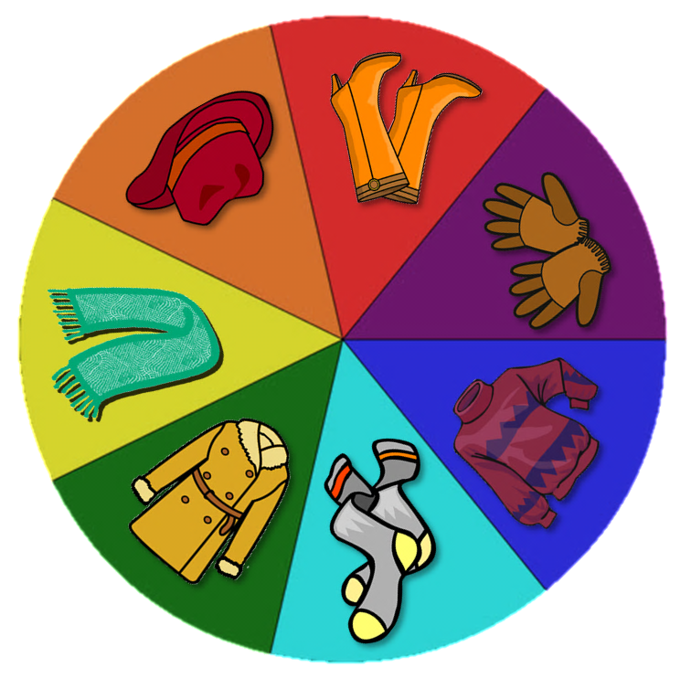
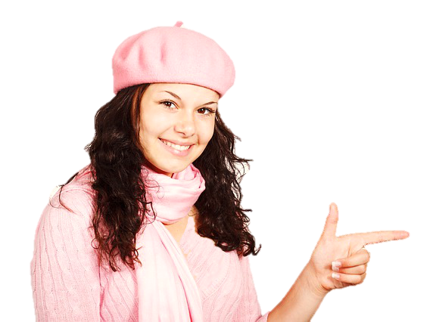
boots
coat
gloves
jumper
What’s this?
scarf
socks
hat
NEXT

Slide 4
boots
coat
gloves
jumper
What’s this?
scarf
socks
hat
NEXT

Slide 5
boots
coat
gloves
jumper
What are these?
scarf
socks
hat
NEXT

Slide 6
boots
coat
gloves
jumper
What’s this?
scarf
socks
hat
NEXT

Slide 7
boots
coat
gloves
jumper
What are these?
scarf
socks
hat
NEXT

Slide 8
boots
coat
gloves
jumper
What’s this?
scarf
socks
hat
NEXT

Slide 9
boots
coat
gloves
jumper
What’s this?
scarf
socks
hat
NEXT

Slide 10
WELL DONE!
CONGRATULATIONS!

Slide 11
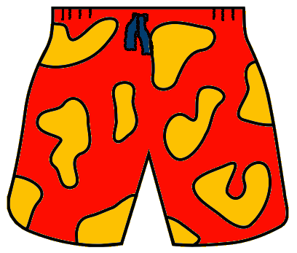
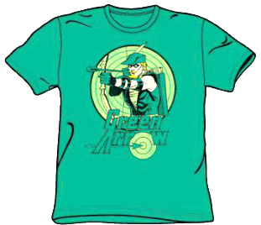
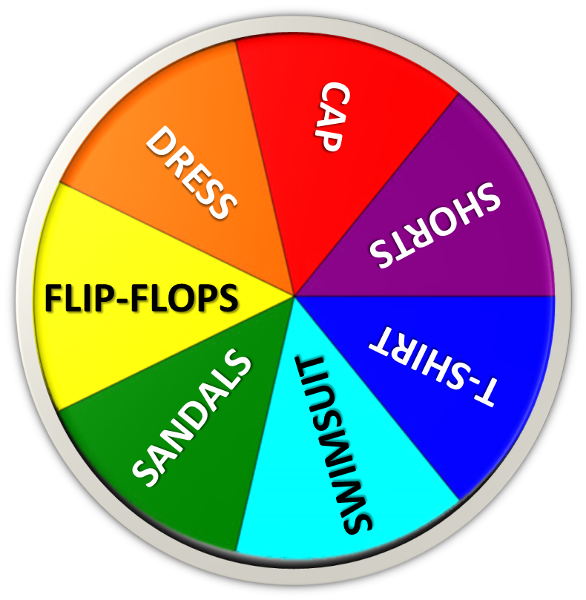
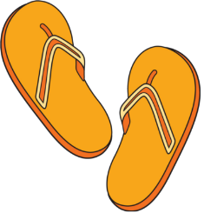
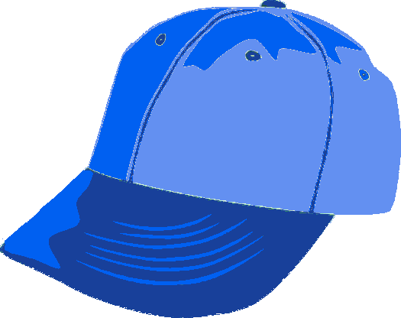
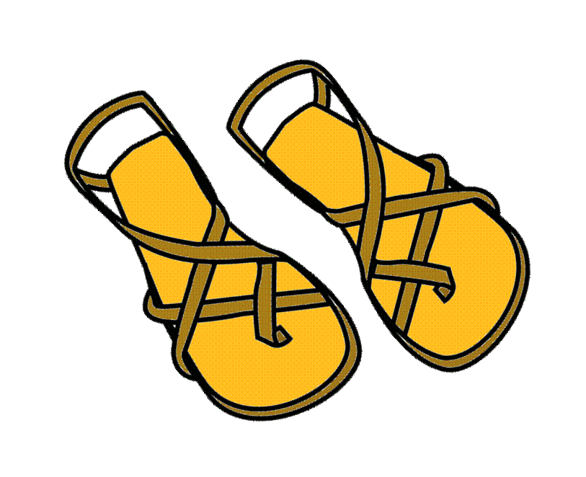
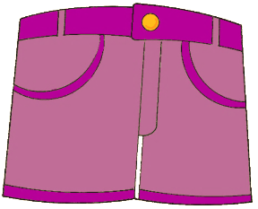
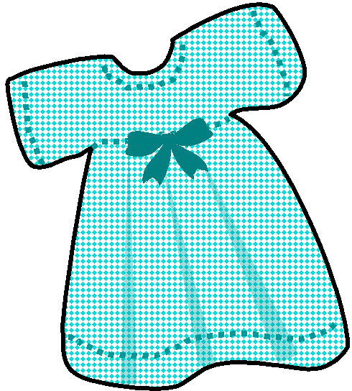
NEXT

Slide 12
NEXT

Slide 13
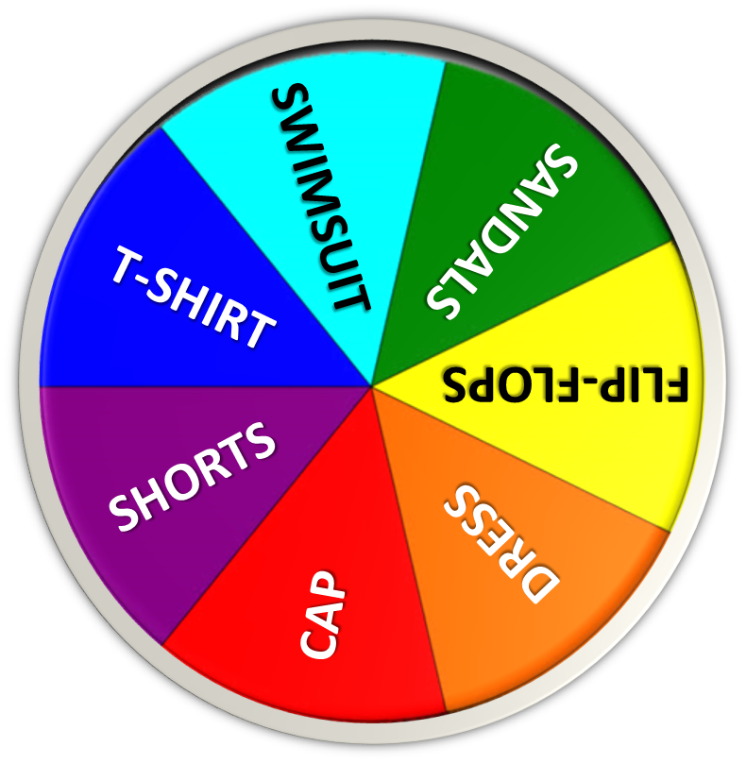
NEXT

Slide 14
NEXT

Slide 15
NEXT

Slide 16
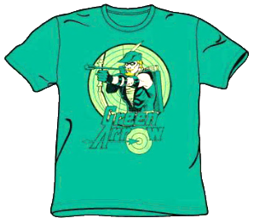
NEXT

Slide 17
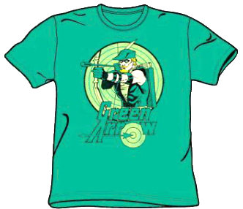
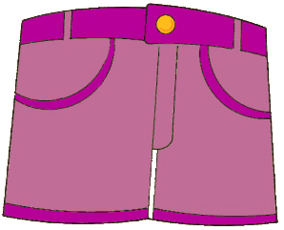
NEXT

Slide 18
WELL DONE!
CONGRATULATIONS!

Slide 19
SB p. 80
It`s snowy and frosty.
It`s going to be rainy next week.
It`s wet and windy.
next

Slide 20
Listen.
next

Slide 21
Listen.
next

Slide 22
What clothes
do you wear
when it is … ?
Rainy
Snowy
Hot
Windy
next

