Slide 1
Ukraine in the world
Demonstrative Lesson
Form 10B
November, 2nd
Mariana Navrotska

Slide 2
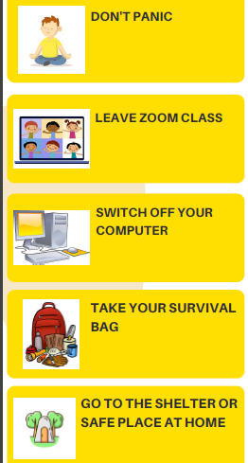
Safety Rules
in case of
air alert

Slide 3
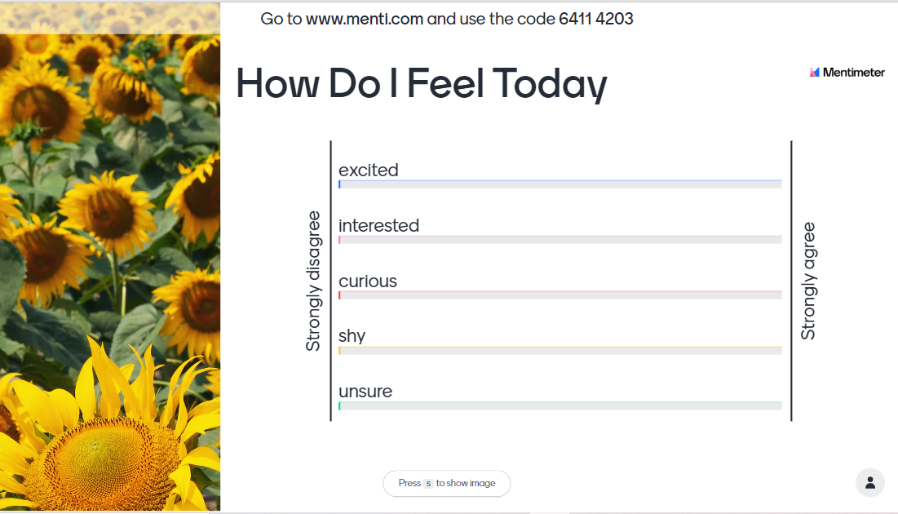
https://www.menti.com/alnef2gh13d2

Slide 4
Pre-listening. Discussion.
What do you think Ukraine is known for all around the world?

Slide 5
Pre-listening. Vocabulary.
folk, adj - relating to the traditional art or culture of a community or nation
unique, adj - being the only one of its kind; unlike anything else
conscious, adj (consciously, adv) - aware of and responding to one's surroundings in a way that involves noticing that a particular thing exists or is present
cuisine, n - the style of cooking that is characteristic of that place (a restaurant, a country or district)
majority, n - the greater number
citizen, n (senior citizen, n) - a person who is a member of a state or country, and has legal rights there; an elderly person, especially an old-age pensioner
cherish, v - to protect and care for someone or something lovingly
за матеріалами Всеукраїнської Школи Онлайн

Slide 6
Listening. Choose the correct option
Alice considers Ukrainian music to be …
powerful
unique
melodic
2. According to Alice Jamala really cherishes …
Crimean Tatar traditions
Crimean Tatar history
Ukrainian culture
Ukrainian traditions
3. What fact about Andriy Shevchenko is Jack impressed by?
His career in Dynamo
His participation in football championships
That he scored 106 goals
4. Why does Jessica know Ukrainian cuisine well?
Her parents belong to the Ukrainian diaspora
She has relatives with Ukrainian roots
She lives in Chicago, where there are many Ukrainians
5. Some of Jessica’s friends after watching HBO series wanted to learn more about Ukrainian culture.
True
False
Doesn’t say
за матеріалами Всеукраїнської Школи Онлайн

Slide 7
Mindfulness Practice
What colour do you associate with Ukraine?
In what season can you find it the most?
What does this colour sound?

Slide 8
What tenses do we use to talk about the future?
Future Simple Tense
Present Continuous Tense
be going to
for plans or arrangements
to express beliefs and predictions about the future
to make offers and promises
to talk about plans or intentions

Slide 9
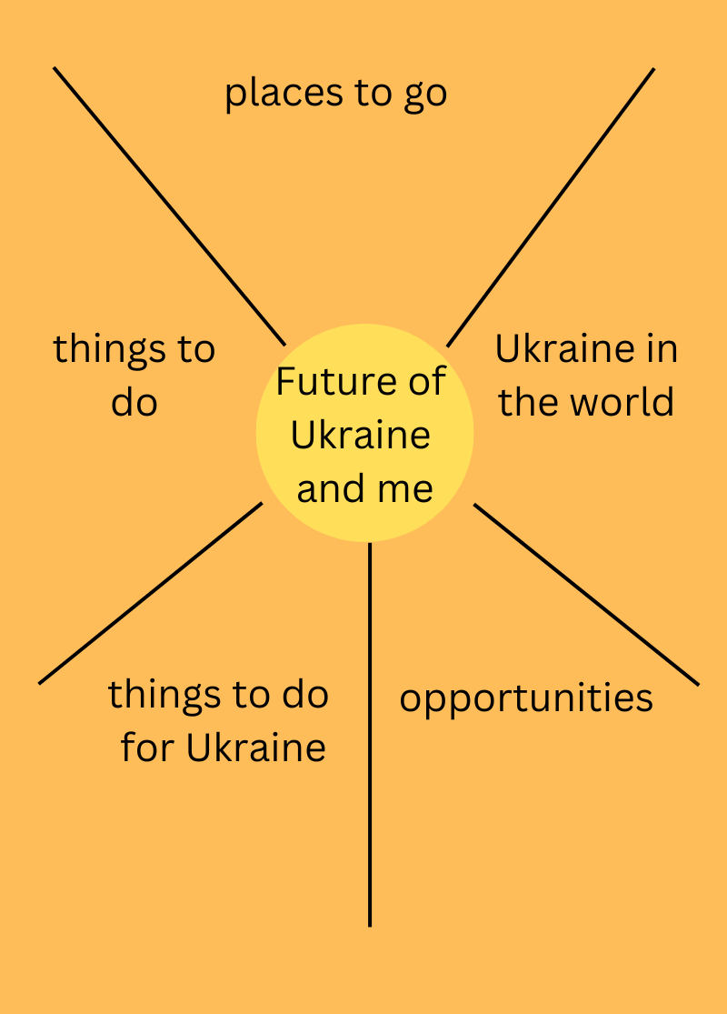
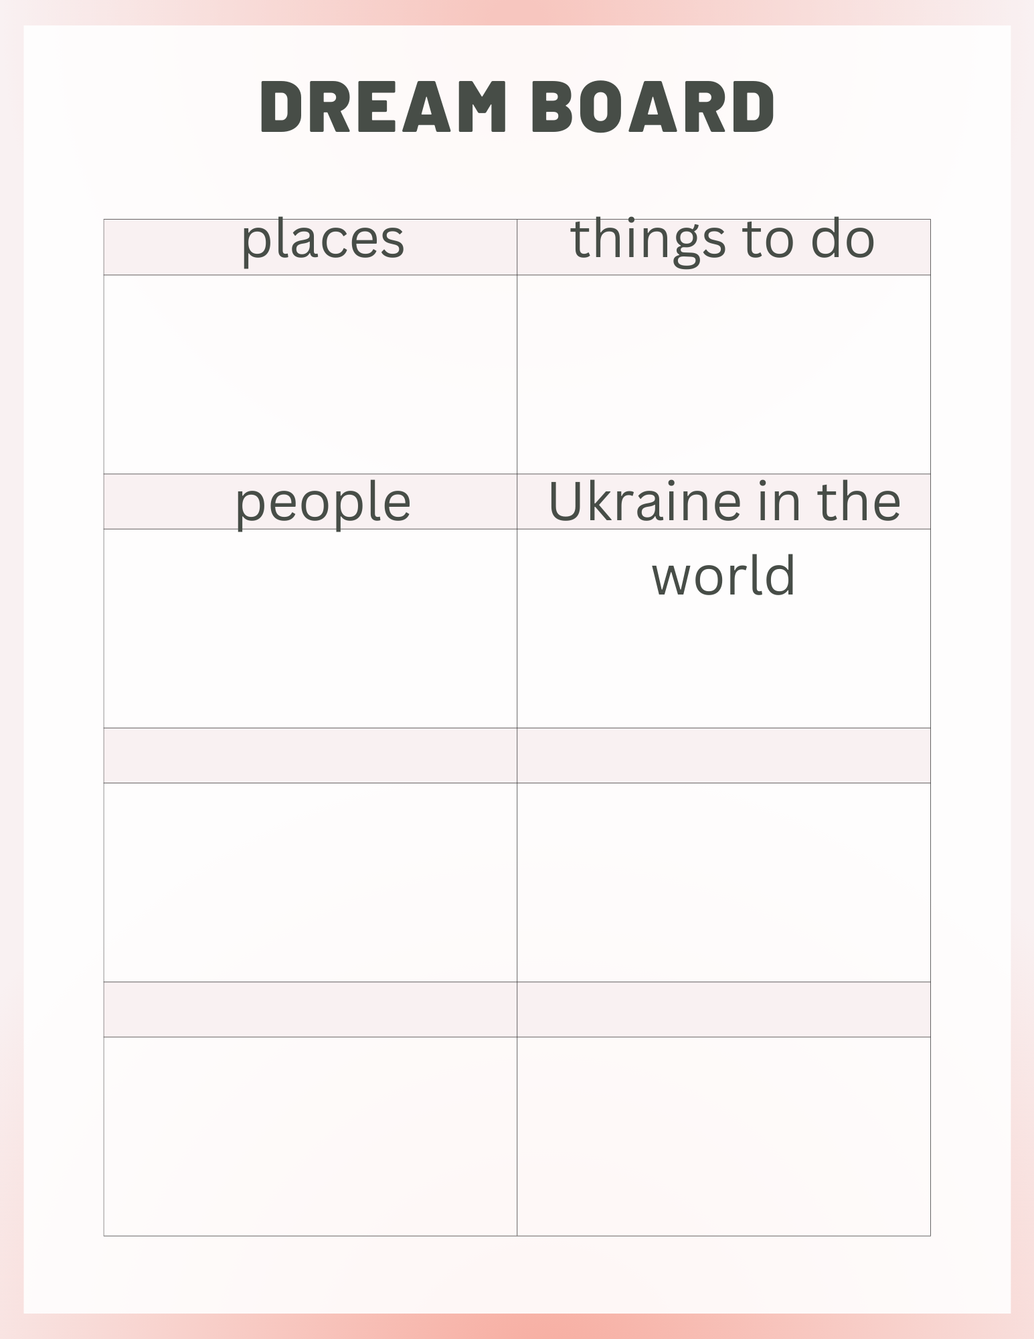
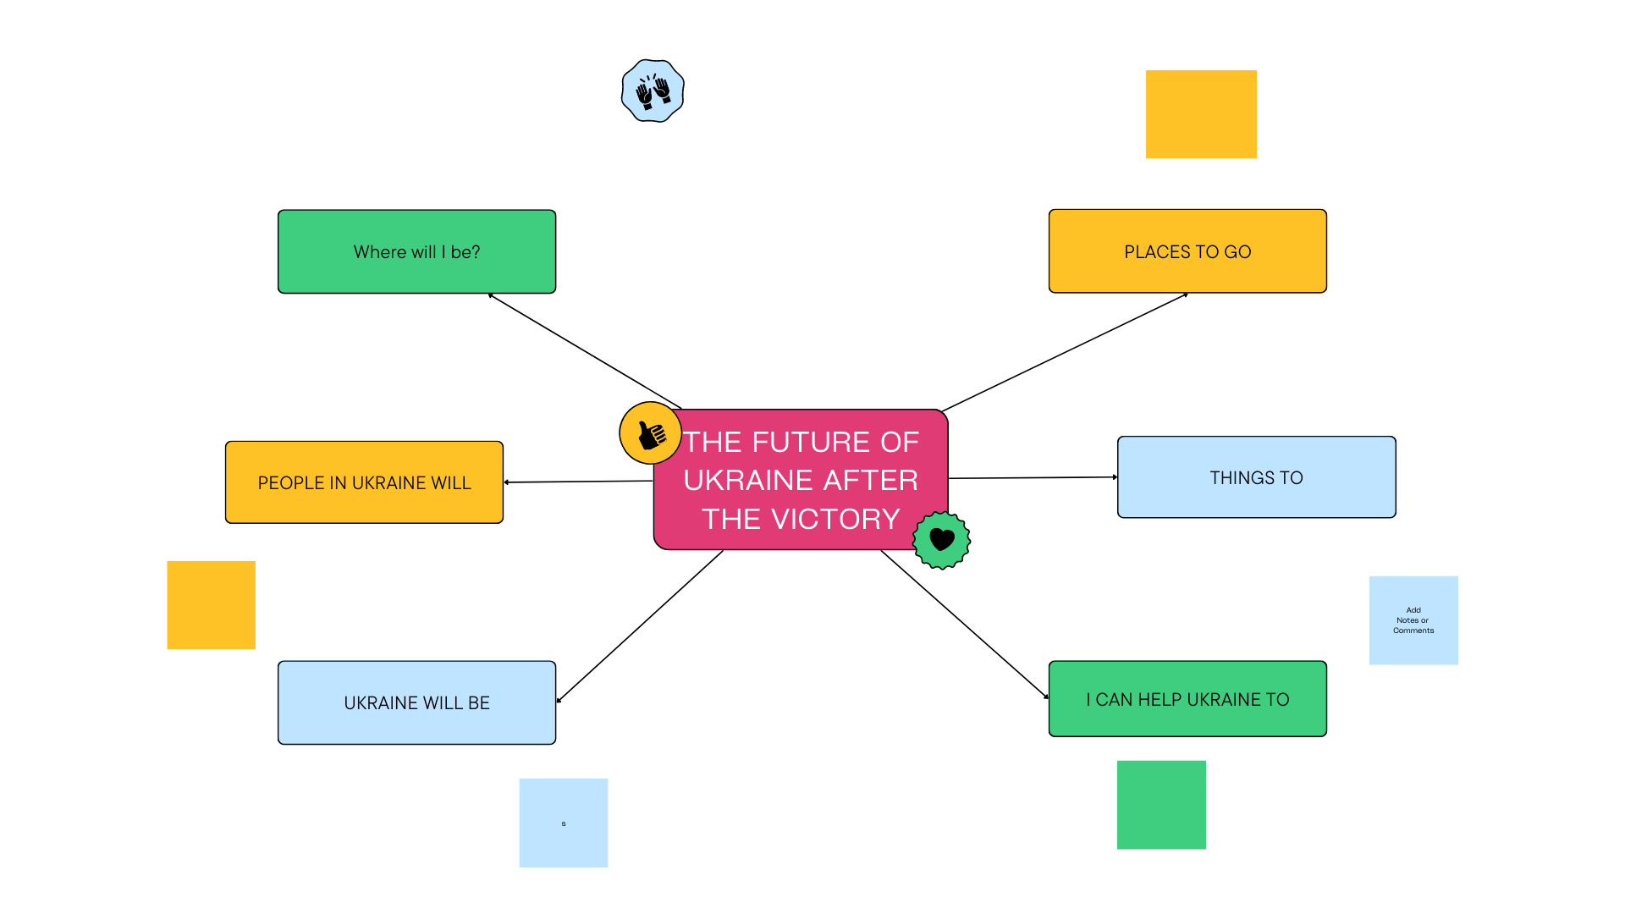
Dream Board “The Future of Ukraine after the Victory”
What places will you visit?
Where will you go?
What will you do?
What will you do for Ukraine?
What will Ukraine be like in the future?

Slide 10
Homework for November, 5th
Think of the places you would like to visit in Ukraine.
Make a top 5 list of them explaining why you want to go there.
Put your homework in Google Classroom.

