Slide 1
In the morning, in the morning
Greet your friends “Good morning!”
When it’s noon, when it’s noon
You must say “Good afternoon”
In the evening, in the evening
Greet your parents “Good
evening”

Slide 2
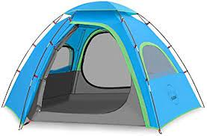
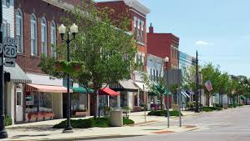
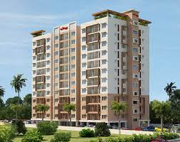
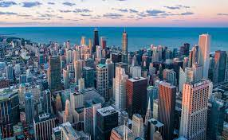
Where do you live?- I live…
in the village in the tent
in the town in the house
in the city in the flat

Slide 3
