Slide 1
Song

Slide 2
How are you today?
It’s time to think.
It’s time to speak.
It’s time to show.
Ready! Steady! Go!

Slide 3
Birthday party.

Slide 4
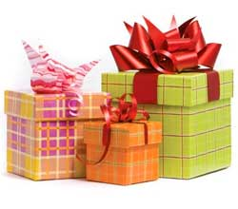
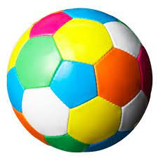
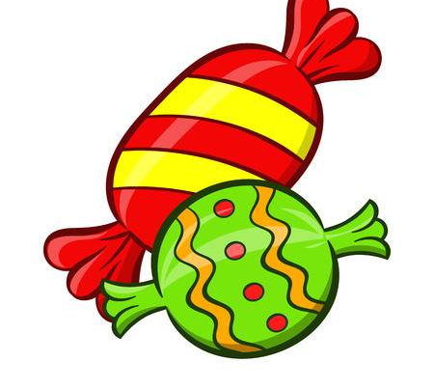
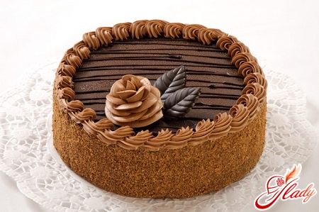
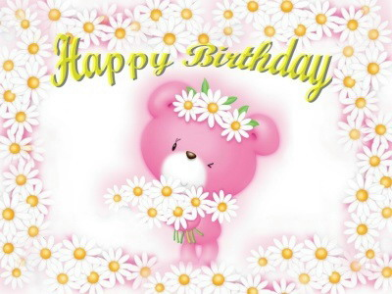
What’s this?
a cake
birthday candles
a birthday card
a birthday hat
presents
balloons
candies
a ball
https://www.liveworksheets.com/rk785409fo

Slide 5
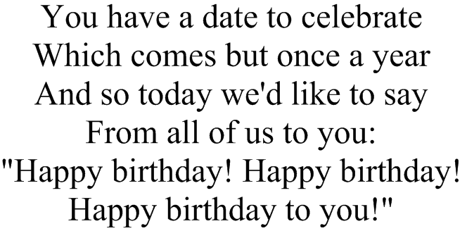
Congratulations
Birthday cakes, birthday cakes,
One for Peter and one for Paul,
An apple, a pear, a plum or a cherry,
And a good present to make us merry!

Slide 6
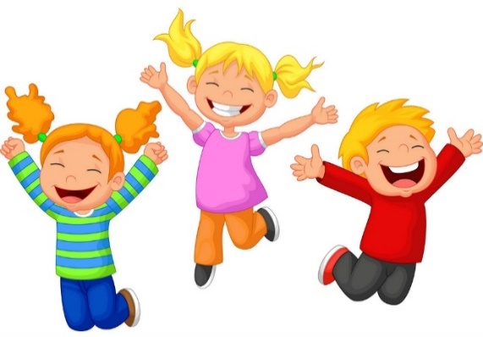
Song

Slide 7
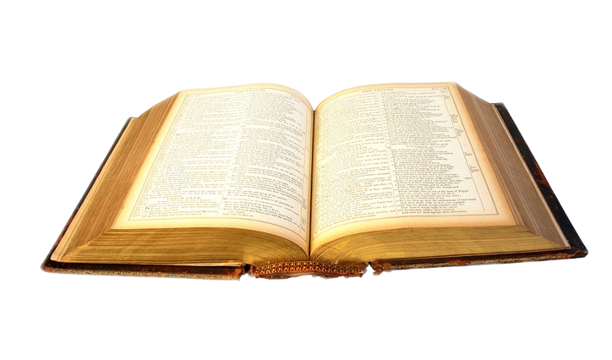
Reading.
Read the text and do the tasks.
Every year Ann has a birthday party. Her friends come to her party. They bring presents and flowers. Ann᾽s mum makes a birthday cake. Ann blows out the candles on the cake. The children sing a “Happy Birthday" song.

Slide 8
Agree or disagree
1. Ann has a birthday party every month.
2. Ann᾽s mother makes a birthday cake.
3. Ann᾽s friends bring book.
4. Ann blows out the candles on the cake.
5. The children usually sing a “ Happy Birthday!” song.
No
Yes
No
Yes
Yes

Slide 9
Let’s have a rest!

Slide 10
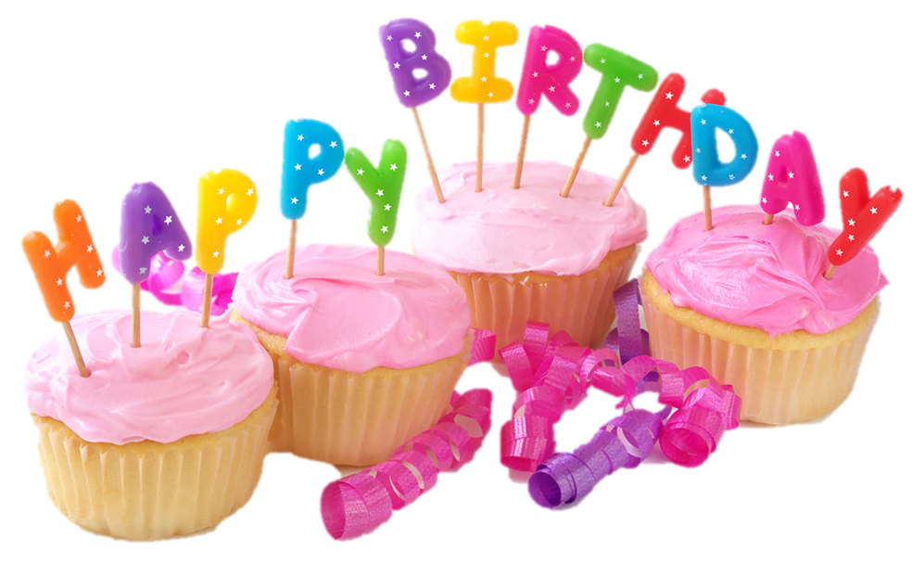
Listening.
Listen and do the tasks.
https://www.liveworksheets.com/vj1638668dj

Slide 11
Writing.

Slide 12
Summing up
T.: Did you like our party? What did you like the most?
Yes, I did. /No, I didn’t.
I liked | - to sing a song.
to play games
to give a present
to see a film
to sing and dance
to read

